Slide 1
Office of the Chief Financial Officer
Writing Defendable Budget Justification
DHS Budget Division:
Erin Dorritie
Jay Anderson

Slide 2
Where are we going for lunch?

Slide 3
Goal of the Budget Justification
Help stakeholders to better understand Department initiatives, strategic goals, and performance outcomes
Inform government decision making
Justify the requested funding levels
Use data and evidence to drive better decision making

Slide 4
Stakeholders – Who are you communicating to?
Components
Department
Office of Management and Budget (OMB)
Office of National Drug Control Policy (ONDCP)
Congress (Appropriations Committees, Authorizing Committees, Individual members)
American Public and Media
We must provide a document that “works” for our Stakeholders
Notes:
Development of the Justification begins at the Program Level

Slide 5
Guidance
Office of Management and Budget (OMB) Circular A-11
Congressional Reports & Appropriations Language
OMB Passback
DHS Financial Management Policy Manual (FMPM)
DHS Budget Build Framework Guidance

Slide 6
What’s the Story?
Develop a theme
Priorities
How does it tie to Administration, DHS, Component strategic vision?
How does it relate to current events?
Making the connection
How is each initiative and topic inter-related?
The story must captivate the reader and gain “buy-in”
It’s not all about the numbers!
The story must focus the reader and gain “buy-in”

Slide 7
Telling your Story
Keep it simple
Organize the justification
Provide relevant budget exhibits
Provide compelling narrative

Slide 8
Telling your Story
Organize the justification
By Purpose and Function – Operations, Acquisitions, Federal Assistance, Research & Development, Fees
By type of request – Continuing current operations, Component Decisions/New Initiatives

Slide 9
Telling your Story
Provide relevant budget exhibits
Topline funding exhibits
What has changed?
Execution exhibits
What are you buying? – Object class is the federal standard

Slide 10
Telling your Story
Provide compelling narrative
What information is necessary?
Description → What is it?
Justification → What does it do? How does it align to Component strategic goals and missions?
Performance → What does success look like?
Costs → What does this cost? How many? What is the timeline to implement?
Anticipating questions

Slide 11
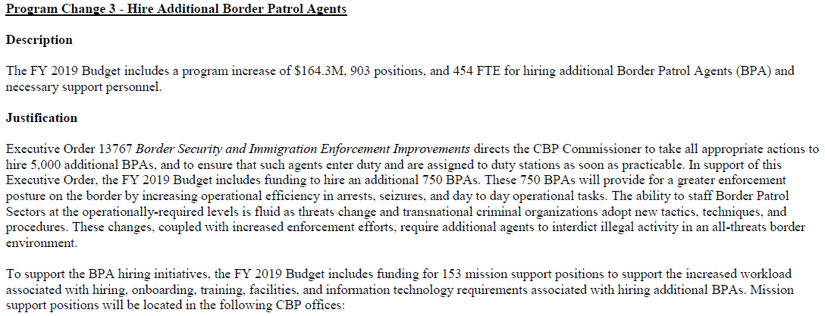
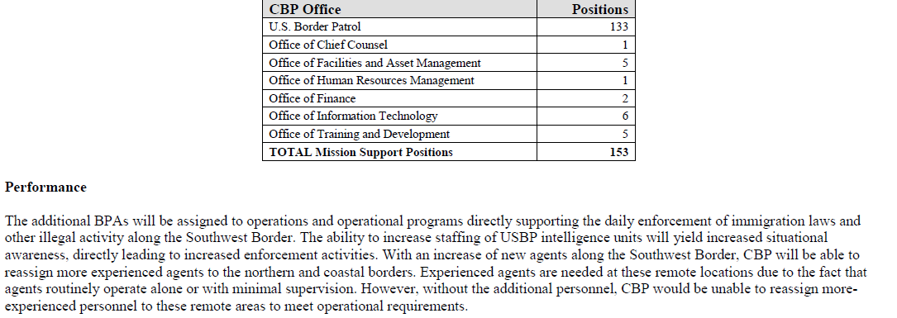
Telling your Story

Slide 12
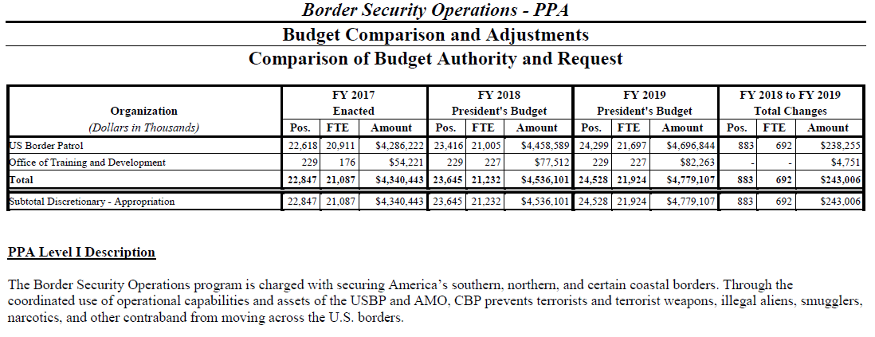
Telling your Story

Slide 13
Telling your Story

Slide 14
Telling your Story?
Length
Accurate, Bold, Concise
Notes:
Accurate
Correct & Truthful (Promise what you can promise)
Bold
Confident/Forthright/Clear
Concise
Short & Sweet
Less is most often more
Eliminate excess words – Every word should have meaning
Goal is to convince Congress to appropriate their limited resources to DHS
Congressional staff will have a short time to review a lot of material
Focus the narrative on the request
The quicker you explain and justify a request, the better
Eliminate narrative justification where is does not impact enactment – this only creates noise and dilutes the story

Slide 15
Telling your Story?
Style and Presentation
Everything is in-line with the Department and Administration
Narrative should explain the budget exhibits
Numbers in narrative MUST match numbers in tables
Data should be used to support arguments
Use most current data & metrics available
Consistent messaging and narrative
Current events and political climate

Slide 16
Feedback - Was it Defendable?
Stakeholder Feedback
Report Language: “woefully inadequate” FY 2016 Reports
New exhibit requirements set forth in the Report Language
Back and forth with OMB review
Additional Requirements from OMB/Congress indicate needed improvement

Slide 17
Recent Feedback
FY 2018 House Report
Always continue to improve!

Slide 18
Recent Feedback
FY 2020 OMB Passback Guidance
Always continue to improve!

Slide 19
Questions

