Slide 1
Accessible Virtual Platforms
May 12, 2021

Slide 2
Introduction
Brandon Pace
HQ Section 508 Program Manager, U.S. Department of Homeland Security
Former President of Deaf & Hard-of-Hearing DHS (employee association)
Certified Professional in Accessibility Core Competencies
Notes:
Disclaimer- we do not speak for all people with disabilities. The experts on accommodations and inclusion of people with disabilities are those people themselves. We are able to provide guidelines and thoughts to consider, but do not consider this canon.
Another disclaimer: We do NOT endorse any companies, organizations, providers, products, or services that will be mentioned during our presentation.

Slide 3
Agenda
Accommodations vs. Accessibility
Challenges and Opportunities
Best Practices
Equipment and Technology Recommendations
Virtual Conferencing Platforms Overview
So how do I pick a platform?
Q&A Session

Slide 4
Quote to share
“
For most people, technology makes things easier. For people with disabilities, however, technology makes things possible.
Mary Pat Radabaugh
Director of IBM’s National Support Center for People with Disabilities
1998
”

Slide 5
Reminder...
Accommodation is not the same as accessibility.
Accommodations are for individuals and are reactive.
Accessibility is for populations and is proactive.
Accessibility should make content available to all, in equally effective ways, at the same time.
Accessibility is the goal, accommodations are just tools to reach it.
Notes:
Types of Accommodations:
Interpreters (American Sign Language (ASL), Tactile ASL, or Protactile)
Support Service Provider, sighted guide, personal assistant
Real-time captioning (CART)
Automatic Speech Recognition* (AKA: automated/live captions)
Assistive Listening Devices
Documents in alternate formats
Braille or Large print
Audio format (text-to-speech)
Electronic methods (email or CD)
Note taking
Extended breaks
Seating locations

Slide 6
Virtual Meetings: Challenges
Platform limitations (Technical)
Environmental limitations (Security, budgetary)
Licensing limitations
Some features not uniformly available (e.g. higher-tier licenses).
Diverse access methods/user interface (UI)
Inconsistent user experience
Turn taking awkwardness
Lack of access to conversational cues
Conflicting accommodations
Limited screen space and bandwidth
Lack of experience and/or training

Slide 7
Virtual Meetings: Opportunities
Interface customization
User control of Assistive Technology
Expanded pool of participants
Geographic, disability, time
Productivity
Richer remote interactions (as opposed to “conference call”)
…?

Slide 8
Virtual Meetings: Universal Meeting Design
Establish a single Point of Contact
Ask for help
Do a technology test in advance
Broadcast the Communication Rules at beginning
Embrace good meeting management techniques
Notes:
Universal design- good meeting practices that help make a meeting more inclusive also make it more PRODUCTIVE for all participants, not just PWD.
Establish a single Point of Contact for meeting logistics and accommodations
Obtain technical support when and if needed
Provide the option for a technology test prior to your meeting.
Implement good meeting management techniques
Develop and distribute Communication Rules prior to your meeting, and review them at the start of every meeting
For example: If you’re not talking, mute your mic/phone and turn off video.
Only one person can talk at a time -- digital audio is not the same as 3D audio if we’re in the same room so if 2 people are talking at the same time, the audio broadcasts out to everybody else as inaudible.

Slide 9
Meeting Management Techniques
Agenda: Distribute a detailed agenda prior to your meeting*
Attendee List: Make available a list of confirmed attendees
Moderator: Assign one participant to serve as meeting moderator
Name Announcements: Remind participants to identify themselves before they begin to speak
Manage turn-taking: Establish a clear procedure (or utilize a digital tool) to manage turn taking
Document sharing: Distribute any relevant documents well in advance of the meeting*
*Any/all document distribution should consider accessibility of those documents (e.g. word format, PDF, plaintext, braille, videos to be captioned & audio described)
Notes:
Agenda: Distribute a detailed agenda prior to your meeting*
Attendee List: Make available a list of confirmed attendees
Moderator: Assign one participant to serve as meeting moderator
Name Announcements: Remind participants to identify themselves before they begin to speak
Manage turn-taking: Establish a clear procedure (or utilize a digital tool) to manage turn taking
Document sharing: Distribute any relevant documents well in advance of the meeting*
*Any/all document distribution should consider accessibility of those documents (e.g. word format, PDF, plaintext, braille, videos to be captioned & audio described)
Communication style: Describe the content of the graphics, speak at a moderate rate and stay on topic for ease of communication
Check In: At the beginning of your meeting take a moment to ask whether all attendees have what they need for effective communication.
Solicit Feedback: Provide a contact for and specifically solicit feedback on accessibility of the meeting.
Screen share sparingly: Screen/content is not accessible to screen readers users, and can take screen space away from video that may be needed. Use with caution, and consider toggling shared content on and off only when needed.

Slide 10
Meeting Management Techniques - continued
Communication style: Describe the content of the graphics, speak at a moderate rate and stay on topic for ease of communication
Check In: At the beginning of your meeting take a moment to ask whether all attendees have what they need for effective communication.
Solicit Feedback: Provide a contact for and specifically solicit feedback on accessibility of the meeting.
Screen share sparingly: Screen/content is not accessible to screen readers users and can take screen space away from video that may be needed. Use with caution and consider toggling shared content on and off only when needed.
Notes:
Agenda: Distribute a detailed agenda prior to your meeting*
Attendee List: Make available a list of confirmed attendees
Moderator: Assign one participant to serve as meeting moderator
Name Announcements: Remind participants to identify themselves before they begin to speak
Manage turn-taking: Establish a clear procedure (or utilize a digital tool) to manage turn taking
Document sharing: Distribute any relevant documents well in advance of the meeting*
*Any/all document distribution should consider accessibility of those documents (e.g. word format, PDF, plaintext, braille, videos to be captioned & audio described)
Communication style: Describe the content of the graphics, speak at a moderate rate and stay on topic for ease of communication
Check In: At the beginning of your meeting take a moment to ask whether all attendees have what they need for effective communication.
Solicit Feedback: Provide a contact for and specifically solicit feedback on accessibility of the meeting.
Screen share sparingly: Screen/content is not accessible to screen readers users, and can take screen space away from video that may be needed. Use with caution, and consider toggling shared content on and off only when needed. This screen content or screen sharing is traditionally not accessible to screen reader users regardless of platform

Slide 11
Equipment and Tech Recommendations
Fine tune your audio
Use a headset whenever possible
Split your audio between input and output; input via device’s built-in microphone, output to headphones or other isolated audio device
Only use one audio connection method (phone or computer, not both)
Fine tune your video
Frame your shot
Consider an external webcam
Disable autofocus if possible
Consider turning off your video when it is not needed*
Provide multiple connection options
Maintain flexibility for your attendees by allowing for as many different connections as possible (e.g. IP audio, phone audio, audio only, video only)
Notes:
This also allows for closer-to-duplex sound transmission. Using a computer’s speakers or speakerphone, or even a smart phone, engages echo cancellation algorithms that may prevent you or others from hearing multiple speakers, causing even more challenges in turntaking.

Slide 12
Platforms: Zoom
Pros | Cons
Highly accessible via screen reader Simple intuitive User Interface (UI) Side by side mode/dual monitor support High quality video/audio with low stutter rate Non-video participants can be hidden Supports up to 100 video participants (350 total) Multi-pinning and multi-spotlight support Offers several options for captioning support Can move captions box around the window | Integrated meeting management tools lack sophistication Security concerns continue to be prevalent, especially amongst government entities Built-in live ASR for paid accounts only (not gov) ASR not identifying speakers
Notes:
One of the most accessible platforms for users of screen readers
Simple intuitive UI allows for ease of use (all users, cognitive disabilities)
Side by side mode and dual monitor support
Allows for more flexibility for ASL users to retain video access while viewing content, and maximize video size
Integrated meeting tools lack sophistication
Handraising tool exists but doesn’t track order, may not be usable for screen reader users
Chat functions can be difficult to distinguish (PMs versus public chat)
Video quality is high
Non-video participants can be hidden to allow screen real estate to remain for signers
Allows for captioning support
Either via third party captioner, or a participant typing into the UI, or use ASR (through Otter.ai)
Captioning display is variable and there are not many options for customizing the display, Brandon will show an example GIF of the captioning’s flaws on Zoom.
Security concerns

Slide 13
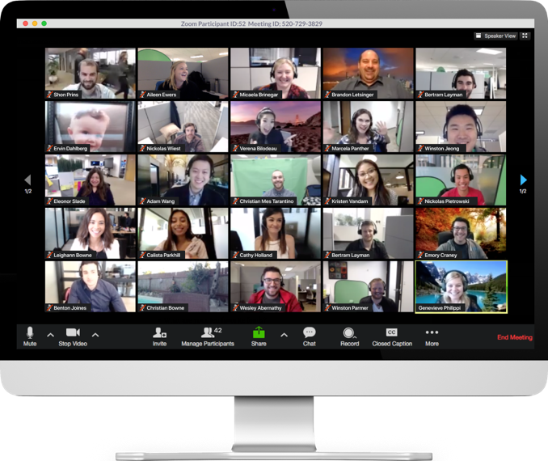
Platforms: Zoom

Slide 14
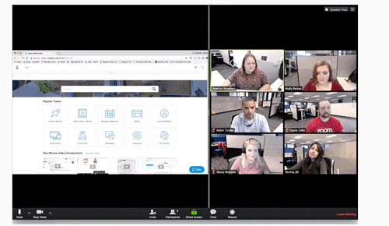
Platforms: Zoom

Slide 15
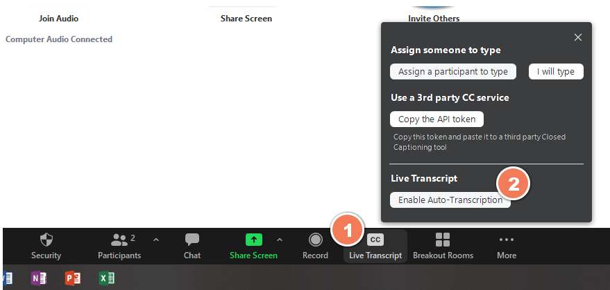
Platforms: Zoom (Enable ASR)
Notes:
This slide is to show you where to enable automatic captioning – but this only happens on paid accounts and you had to go into 3 different settings within your Zoom account to finally get this option to show up. Not so convenience.

Slide 16
Platforms: Zoom (Roll-up captioning)
Notes:
Zoom finally released update to their captioning interface where it will display as roll-up captions which places them in a much better place from an accessibility angle.
Nevertheless, StreamText (or other standalone caption display) is the ultimate solution for users overall, especially for those who are DeafBlind or low-vision.

Slide 17
Platforms: Cisco WebEx
Pros | Cons
Easy to procure; security and enterprise ready Latest version offers ASR captions Capability to create a separate module for CART captioning (Multimedia viewer) Centralized feature management (administrators) | Not usable for screen reader users. Complex user interface requires training to navigate Unintuitive video “pinning” functionality No CART support; ASR not identifying speakers Inflexible video interface Centralized feature management (administrators) Additional steps to join a meeting
Notes:
Unintuitive video “pinning” functionality
Pins are based on frames, not on individuals
“locking” a video with a pin removes flexibility for users to pin for themselves
Retaining flexibility and customization for users who need access to interpretation or other accommodations would mean not “locking” the display into one mode, unless that mode prioritizes all accommodations.
Inflexible video interface
Non video participants cannot be hidden, contributing to tiny videos on screen
More secure and enterprise ready
Not usable by screen reader users

Slide 18
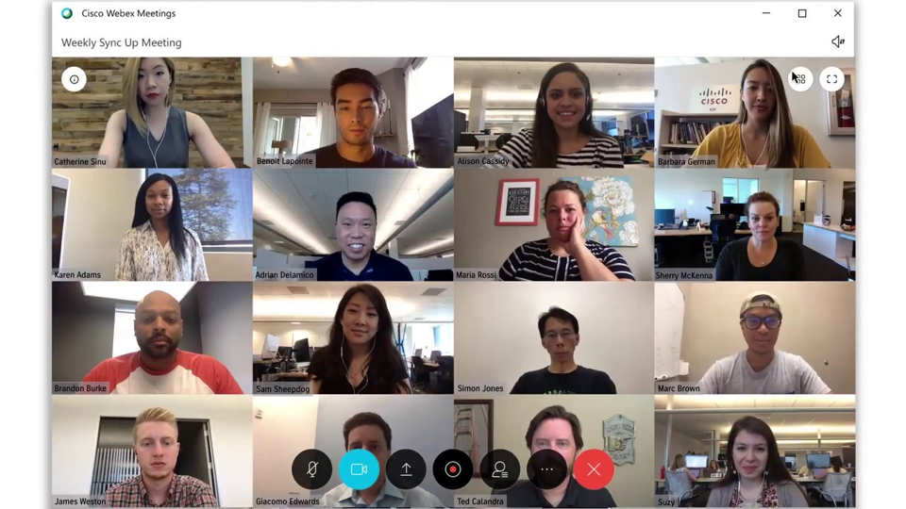
Platforms: Cisco WebEx

Slide 19
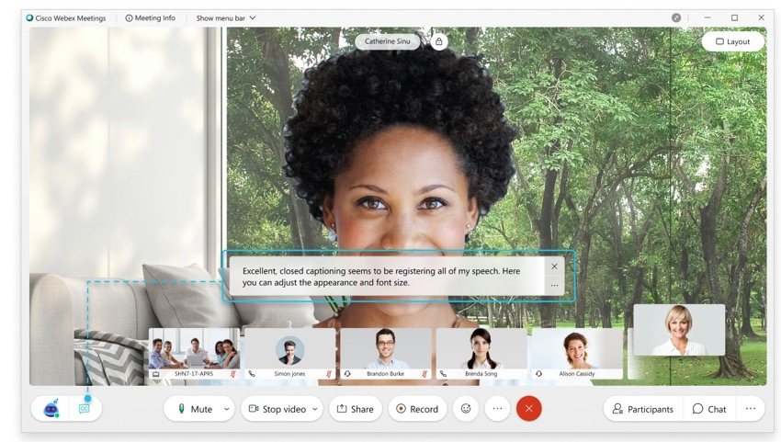
Platforms: Cisco WebEx

Slide 20
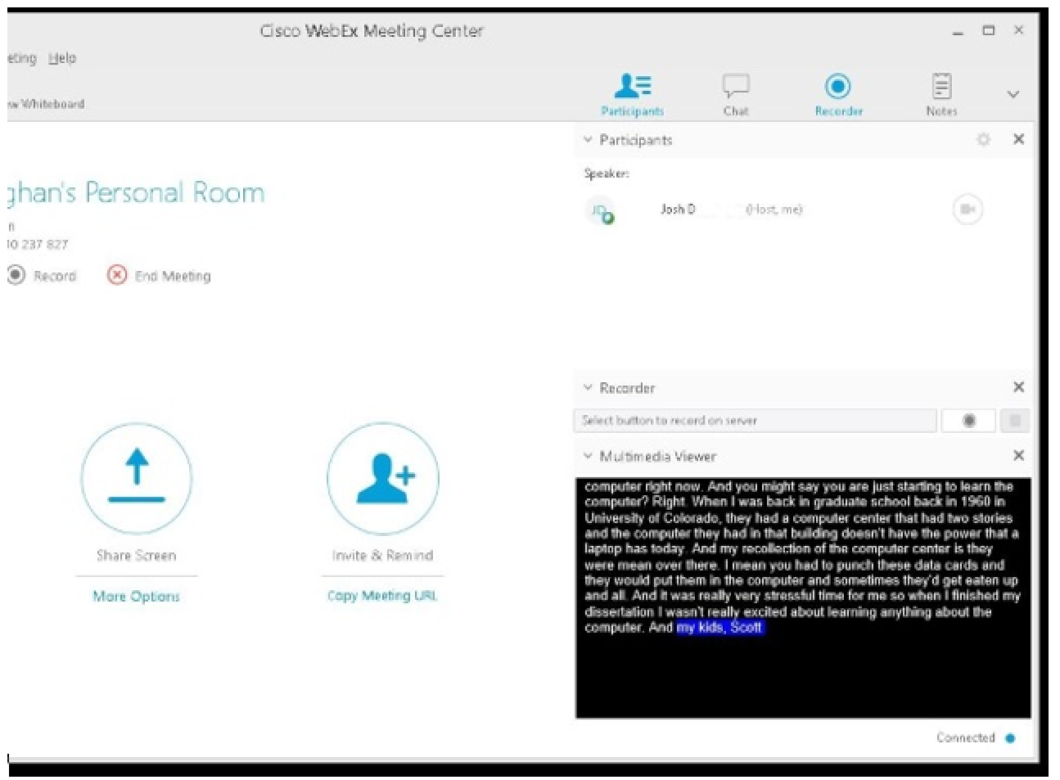
Platforms: Cisco WebEx

Slide 21
Platforms: Google Meet
Pros | Cons
Approved for some agencies Easy to use and intuitive Automated captioning has high accuracy and names speakers (isolated audio channels) Grid layout for video Screen reader and keyboard accessible Audio via phone connection Browser based- no download required | Not widely available to government agencies Max number of video participants depends on license (100, 150, 250)

Slide 22
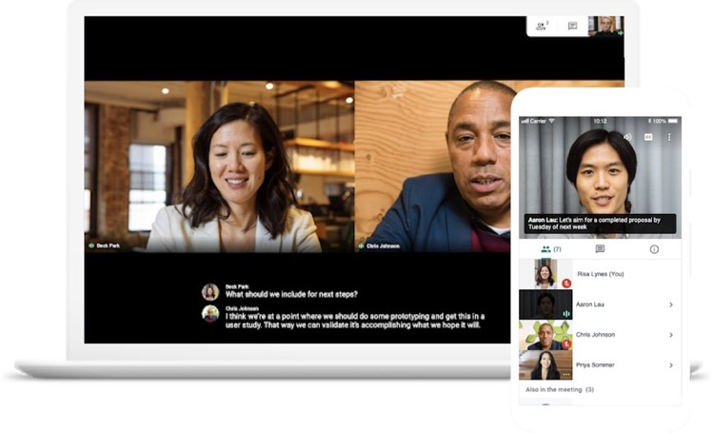
Platforms: Google Meet

Slide 23
Platforms: Adobe Connect
Pros | Cons
Majority of federal agencies use it Easy to procure; security and enterprise ready Grid layout for video feed Maximum user interface flexibility; can add a dedicated pod for captioning HTML5 client and desktop application available Accessible for screen readers and keyboard shortcuts | Bandwidth intensive Complex user interface No video pinning functionality Requires additional licenses for add-ons such as conference lines
Notes:
Adobe is actively working to roll out new video enhancements, such as new audio and video codec to improve video quality while compressing bandwidth.
Good news - Adobe is also working on a brand-new “pod-less” Closed Captioning capability that will be coming to Adobe Connect soon within the next few months, if not before the summer.

Slide 24
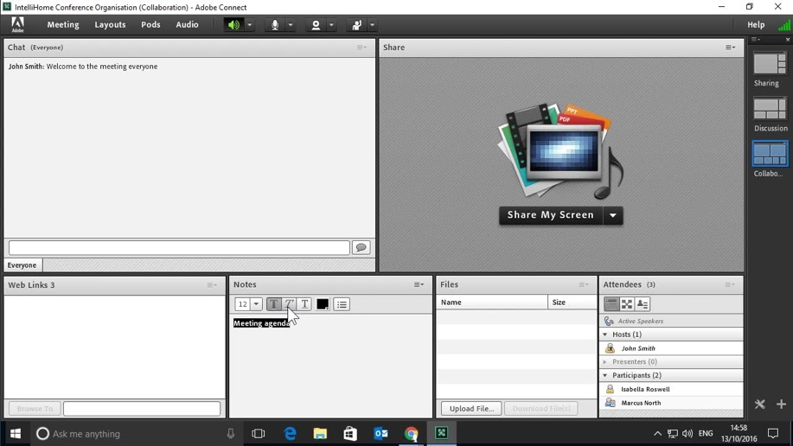
Platforms: Adobe Connect

Slide 25
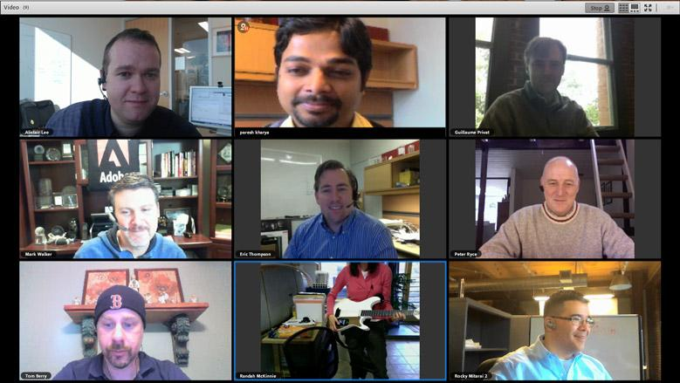
Platforms: Adobe Connect

Slide 26
Platforms: Adobe Connect

Slide 27
Platforms: Microsoft Teams
Pros | Cons
Easy to procure; security and enterprise ready Available to almost all government agencies with Office 365 Built-in across Office 365 applications for real-time collaboration Embedded invite for one click meetings via Outlook Multi-pinning enabled | “All-in-one” platform with numerous features that may confuse users Not user-friendly & not intuitive Known accessibility issues (e.g. guests unable to pin) Captioning only feasible using Azure ASR; CART support is underway License dilemma to obtain alternative methods for accommodations (e.g. call-in feature)
Notes:
Product not very accessible/usable for screenreader users (though Microsoft is aware of issues and providing training, working on fixes)
Brandon to explain more about G1/G3/G5 licensing dilemma
Both Microsoft and the U.S. Federal Government are coordinating where multiple accessibility defects are being resolved. While I wish I can share more information, what I can share at this time is that Microsoft is actively working to fill in the gaps to improve the user experience for people with disabilities.

Slide 28
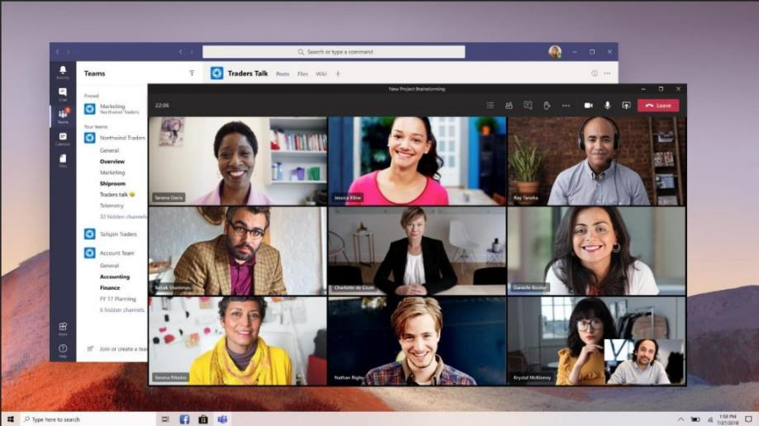
Platforms: Microsoft Teams

Slide 29
Platforms: Microsoft Teams (Captioning example)

Slide 30
Platforms: Live Streaming
Pros | Cons
Less bandwidth More control of broadcasting various content and video feeds to audience, especially picture-in-picture ASL interpreter and burn-on captioning Ease of access to virtually everybody who have a computer or mobile device | Requires many moving parts along with technical-intensive knowledge to implement solutions, especially with accessibility Burn-in or embedded captions on streams are not accessible to screen reader or refreshable braille display users Streaming services can be over reliant on ASR generated captioning Does not allow for a great degree of user customization
Notes:
Recommend maintaining the video conference interface for participants/speakers only, stream the content of the conference
Ensure that captions are available in alternative form that is screen reader friendly (e.g. Streamtext) while feeding captions to multiple platforms at the same time

Slide 31
Platforms: Live Streaming (Bad example)
Notes:
ASL = way too small
Captions = pop-out, not scrolling, and sometimes would show up and disappear too fast, not allowing people to finish reading what’s being said

Slide 32
Platforms: Live Streaming (Good example)
Notes:
ASL = picture-in-picture while making it large enough for it to be visible even on a small mobile device like an iPhone.
Captioning = used built in platform’s captioning feed - which allows DeafBlind population to customize their styling preferences for better viewing experience (unlike Zoom or Teams)
Notice the scrolling captioning? Much better so people can read at their own pace

Slide 33
Platforms: Live Streaming (Size & Transition)
Notes:
This video did have captioning - I turned it off to show you the slide transition and the size chose for representation
Take a close look where the interpreter and the Governor are almost (or is) the same size. It is an indication that the message being conveyed by these 2 people in the same amount/size using different languages representing accessibility, equity and inclusion.
Also, when they make a transition to show a slide, they do not resize the interpreter which is also a great representation for accessibility

Slide 34
Platforms: Live Streaming (Burn-on Captions)
Notes:
It’s AWESOME to have burn-on captions for many reasons… burn-on captions allows media specialists to broadcast out a single video feed to multiple platforms without worrying about accommodating the configuration differences in various platforms’ captioning. For example, Facebook and Twitter have different ways on how to receive the captions feed, and it’s already difficult enough to configure the caption feed to send out to a major social media platform, let alone two or more.
HOWEVER, this may come a surprise to you… burn-on captions would be much more accessible for Deaf people who doesn’t have a vision disability. So, that means burn-on captions are still not 100% accessible. In Delaware’s case, the DeafBlind population would have a difficult time reading the captions which was probably set to 75% opacity (25% transparent?). Because there are no caption feeds to a major platform, the DeafBlind population wouldn’t be able to configure the captions to their styling preferences such as changing the font size to a larger text or even the font color to yellow. Hence our recommendation for StreamText URL to be provided in the event’s description at the same time when trying to ingest captions into live streaming platforms at the same time.

Slide 35
Platforms: Virtual Event Platform
Pros | Cons
Less bandwidth More control of broadcasting various content and video feeds to audience, especially picture-in-picture ASL interpreter and burn-on captioning Ease of access to virtually everybody who have a computer or mobile device Some vendors incorporated accessibility features in their platform and/or design | Cost-intensive Requires many moving parts along with technical-intensive knowledge to implement solutions, especially with accessibility Burn-in or embedded captions on streams are not accessible to screen reader or refreshable braille display users Does not allow for a great degree of user customization
Notes:
Basically the pros and cons from YouTube live streaming are very similar for platforms designed to host virtual events. One major difference is that it is very cost-intensive. Many of those companies did not think of accessibility while they built their platform. When I was reaching out to those vendors for quotes and accessibility reviews, one vendor wanted to invest their time and staffing resources to remediate accessibility defects which was a great sign. That vendor actually created a “picture-in-picture” box for ASL interpreter and users can toggle it on or off and that PIP box can be moved anywhere where you want on the screen. The same thing for captions, although at that time, they’re using ASR but they’re working to add capability for CART stenographers.

Slide 36
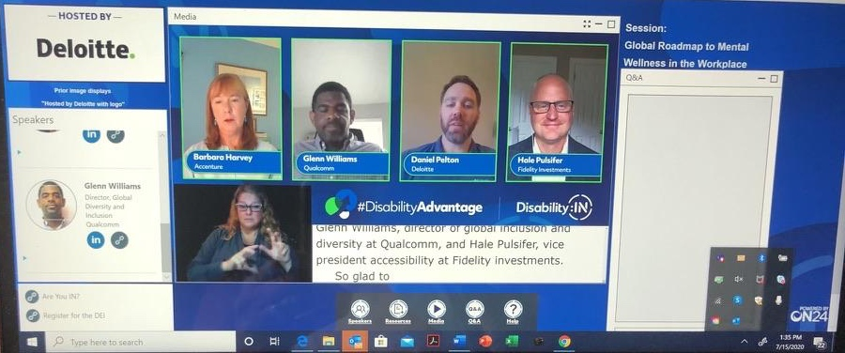
Platforms: Virtual Event Platform
Notes:
Demonstration of panelists with ASL and CC

Slide 37
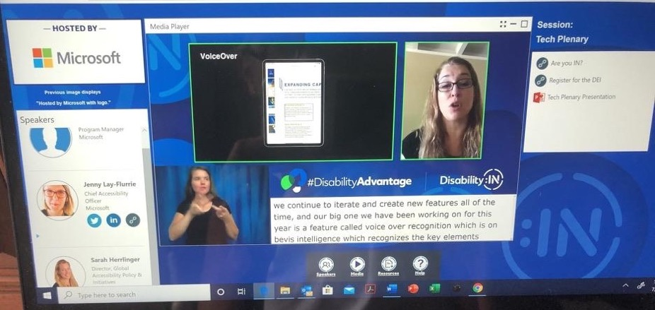
Platforms: Virtual Event Platform
Notes:
Demonstration of PowerPoint slides showing along with the speaker video next to it. Below is ASL and CC support

Slide 38
So how do I pick a platform?
None of the virtual meeting platforms are perfect.
Sorry
Check with your agency/organization to identify which platforms you already have access to
Engage people with disabilities to test and evaluate those platforms with you
Implement meeting management strategies to compensate for weaknesses in your platform
Utilize other services as possible to compensate for weaknesses in your platform (e.g. separate captioning streaming website, hand raising tool)

Slide 39
Wrap Up
Ask: “How can I help?”
Don’t let the perfect be the enemy of the good, but…
Don’t stop collecting feedback and iterating
Stay flexible
Spend time to save time
Archived Presentation (conjoined with FCC) https://www.accessibilityonline.org/cioc-508/archives/110839
Notes:
Brandon to lead

