Slide 1
Deque – Tools for Digital Equality
DHS Accessibility Day – May 13, 2021
Presented by Allen Hoffman and Noah Mashni

Slide 2
Overview
Challenges developing accessible content
Perfect as enemy of good enough
How automation helps more than you might think

Slide 3
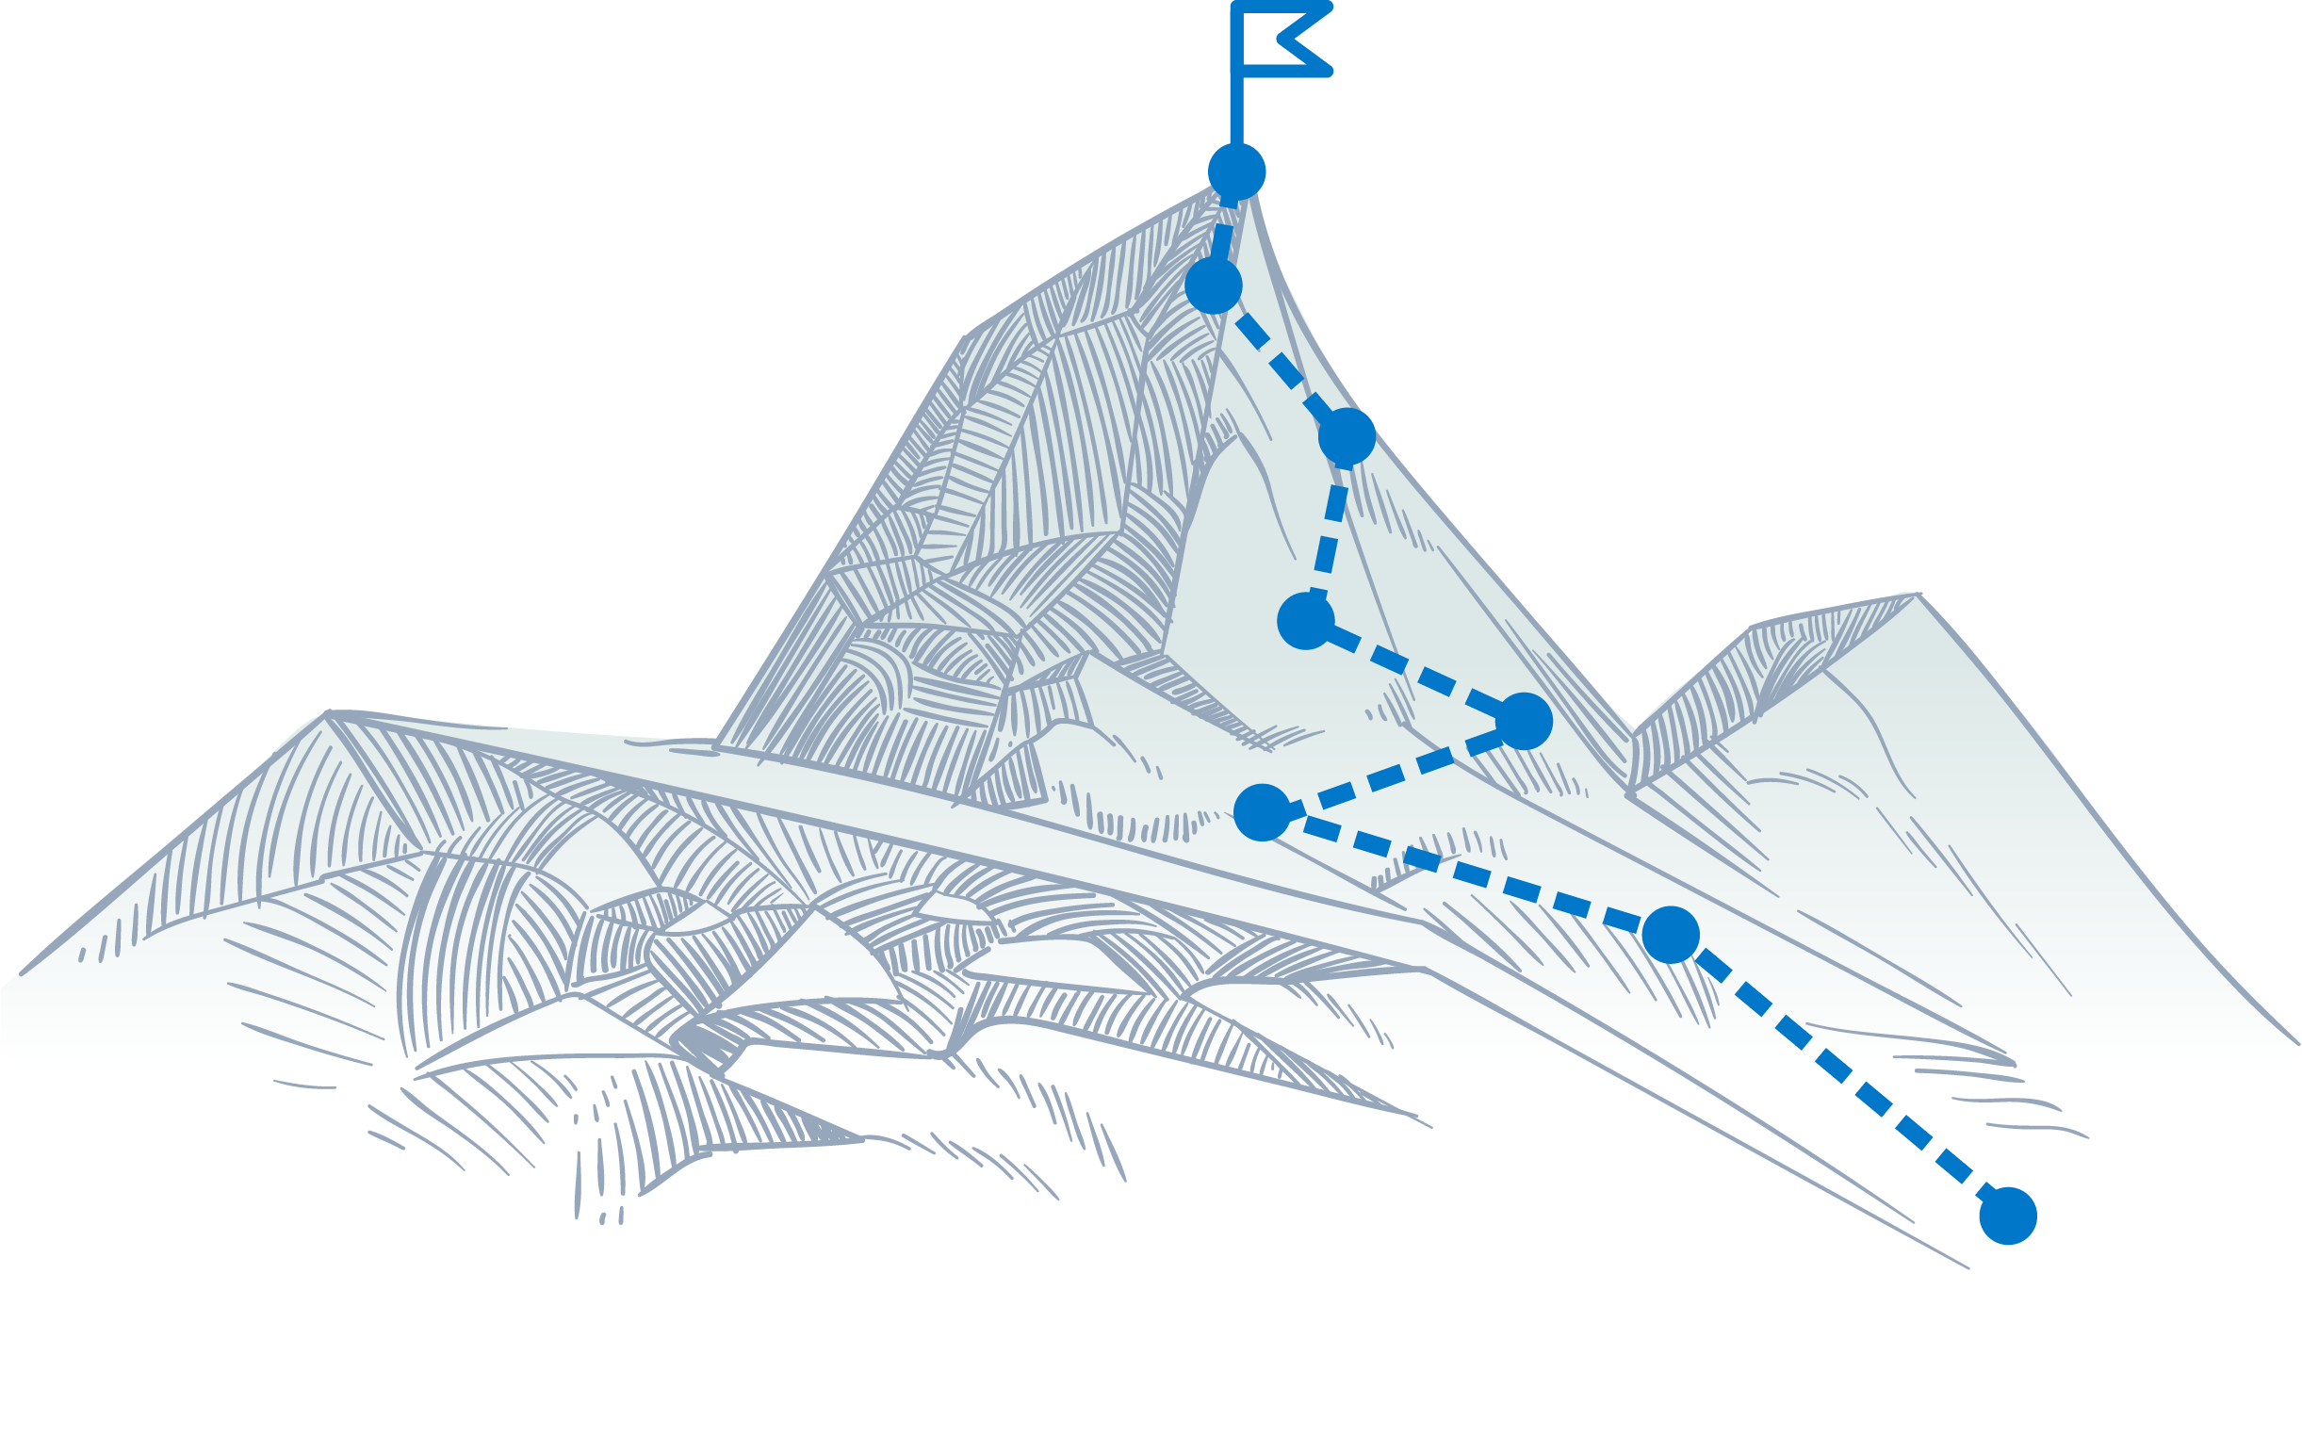
Challenges for Developing Accessible Content
Lack of motivation
Lack of understanding
Lack of opportunity

Slide 4
Perfect as the Enemy of Good
WCAG has lots and lots of success criteria
Most accessibility issues arise from only a subset of the whole list of success criteria

Slide 5
WCAG 2.1 A/AA SC with Most Issues
Deque Comprehensive Audits for New Clients
# | Success Criteria # | Success Criteria Name | Total issues | Manual issues | Auto issues | Manual % | Auto % | % of ALL Issues by SC | Cumulative % of Issue
1 | 1.4.3 | Contrast (Minimum) | 88,714 | 14,981 | 73,733 | 16.89% | 83.11% | 30.08% | 30.08%
2 | 4.1.2 | Name, Role, Value | 48,287 | 22,011 | 26,276 | 45.58% | 54.42% | 16.37% | 46.45%
3 | 1.3.1 | Info and Relationships | 36,382 | 19,950 | 16,432 | 54.83% | 45.17% | 12.33% | 58.78%
4 | 4.1.1 | Parsing | 34,488 | 3,351 | 31137 | 9.72% | 90.28% | 11.69% | 70.47%
5 | 1.1.1 | Non-text Content | 23,701 | 7,687 | 16,014 | 32.43% | 67.57% | 8.04% | 78.51%
6 | 2.4.3 | Focus Order | 9,553 | 9,553 | 0 | 100.00% | 0.00% | 3.24% | 81.75%
7 | 2.1.1 | Keyboard | 9,412 | 9,178 | 234 | 97.51% | 2.49% | 3.19% | 84.94%
8 | 2.4.7 | Focus Visible | 7,312 | 7,312 | 0 | 100.00% | 0.00% | 2.48% | 87.42%
9 | 1.4.11 | Non-text Contrast | 4,539 | 4,539 | 0 | 100.00% | 0.00% | 1.54% | 88.96%
10 | 1.4.1 | Use of Color | 3,713 | 3,261 | 452 | 87.83% | 12.17% | 1.26% | 90.22%
11 | 1.3.2 | Meaningful Sequence | 3,313 | 3,313 | 0 | 100.00% | 0.00% | 1.12% | 91.34%
12 | 3.3.2 | Labels or Instructions | 2,537 | 2,019 | 518 | 79.58% | 20.42% | 0.86% | 92.20%
13 | 2.4.1 | Bypass Blocks | 2,533 | 532 | 2,001 | 21.00% | 79.00% | 0.86% | 93.06%
14 | 2.4.2 | Page Titled | 2,211 | 1,962 | 249 | 88.74% | 11.26% | 0.75% | 93.81%
15 | 3.1.1 | Language of Page | 2,173 | 178 | 1,995 | 8.19% | 91.81% | 0.74% | 94.54%
 | #.#.# | Rest of WCAG 2.1 A/AA SC | 16,090 | 15,889 | 201 | 98.75% | 1.25% | 5.46% | 100.00%
 |  | Totals | 294,958 | 125,716 | 169242 | 42.62% | 57.38%

Slide 6
Deque Big Data (from axe auditor + axe-core)
94.54% of all WCAG 2.1 issues found fell into 15 Success Criteria!
57.38% of all WCAG 2.1 issues were found with axe-core (automation)
42.62% of all WCAC 2.1 issues were found with manual testing

Slide 7
Automation can help more than you think
Automation coverage for accessibility is more than the success criteria covered by a tool – when looking at the actual issues in the wild automation can cover 57.38% of all issues
Creating a plan for handling the less likely, more edge issues is a good idea
Guided automated testing can find 72-83% of all of your WCAG issues!!

Slide 8
Demo Time: axe DevTools Automation and Intelligent Guided Test (IGT)

Slide 9
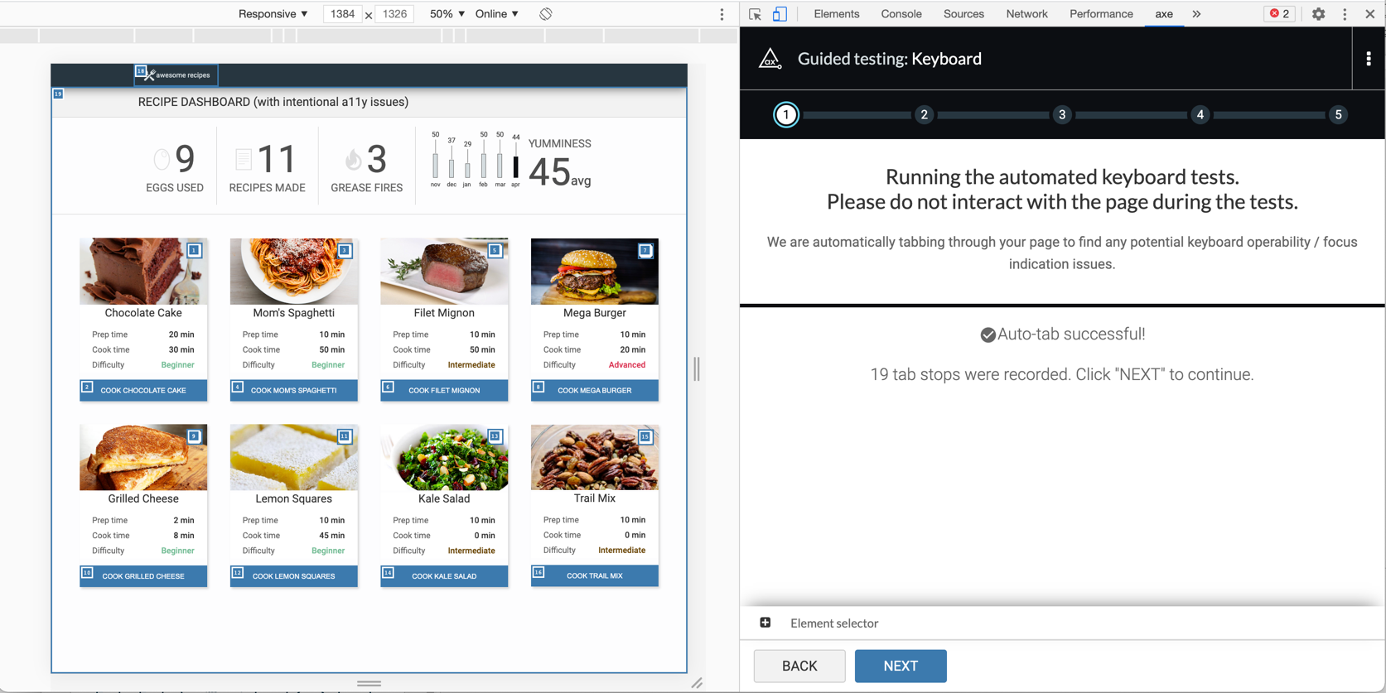
Intelligent Guided Tests for Developers
Page Information
Page Title
Language
Headings
Lists
Images
Buttons and Links
Keyboard
Modals / Focus Management
Forms
Labels, error messages, required fields…

Slide 10
Questions
Accessibility Coverage Report: deque.com/coverage-report

