Slide 1
Accessibility at Google
Building Inclusively
Christopher Patnoe
Head of Accessibility Programs & Disability Inclusion, Google
patnoe@google.com

Slide 2
Why is inclusion important?

Slide 3
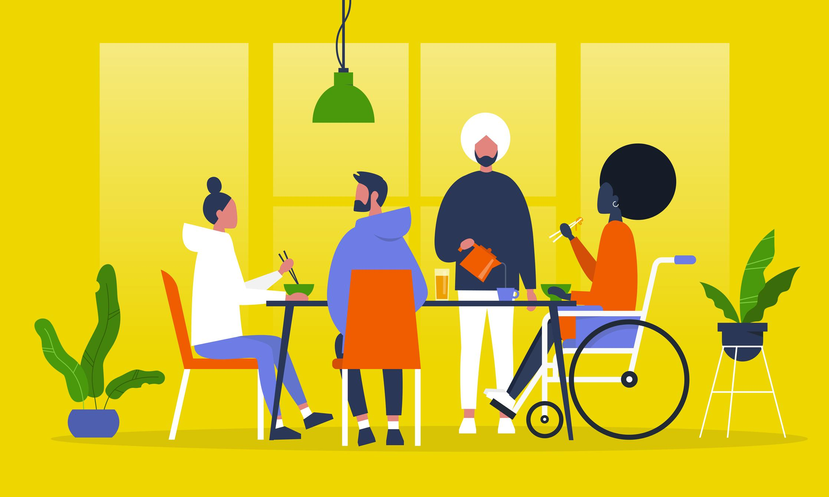
99.9% of our DNA is common
We are far more common than different so differences tend to be...
exaggerated.

Slide 4
99.9% of our DNA is common
We are far more common than different so differences tend to be...
exaggerated.
ignored.

Slide 5
99.9% of our DNA is common
We are far more common than different so differences tend to be...
exaggerated.
ignored.
But if we are 99.9% similar, don't we have an obligation to be there for each other?
Work in Accessibility is one way of doing this.

Slide 6
Personal Story

Slide 7
Personal Story
Image Source: Wikipedia

Slide 8
Personal Story

Slide 9
Personal Story
"button-holed"
Image Source: Wikipedia
Notes:
talk about what I'm leading

Slide 10
Google and Accessibility

Slide 11
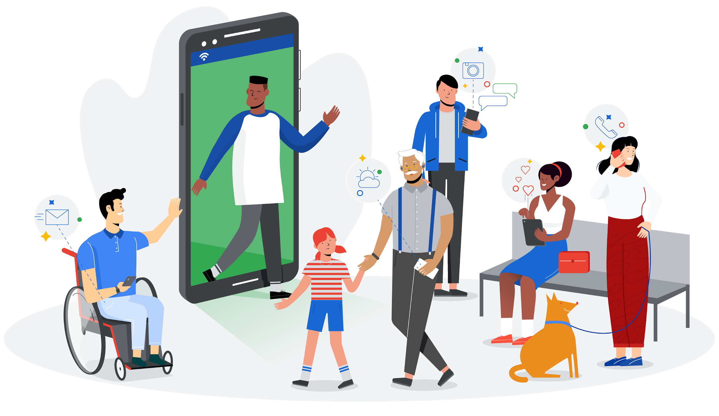
Intro | Mission
Accessibility
is part of Google’s Mission
To organize the world's information and make it universally accessible
and useful
Notes:
Accessibility's Mission is integral to Google. So integral, it’s in our mission statement; “to make the world’s information universally accessible and useful”
So let’s unpack this a bit...

Slide 12
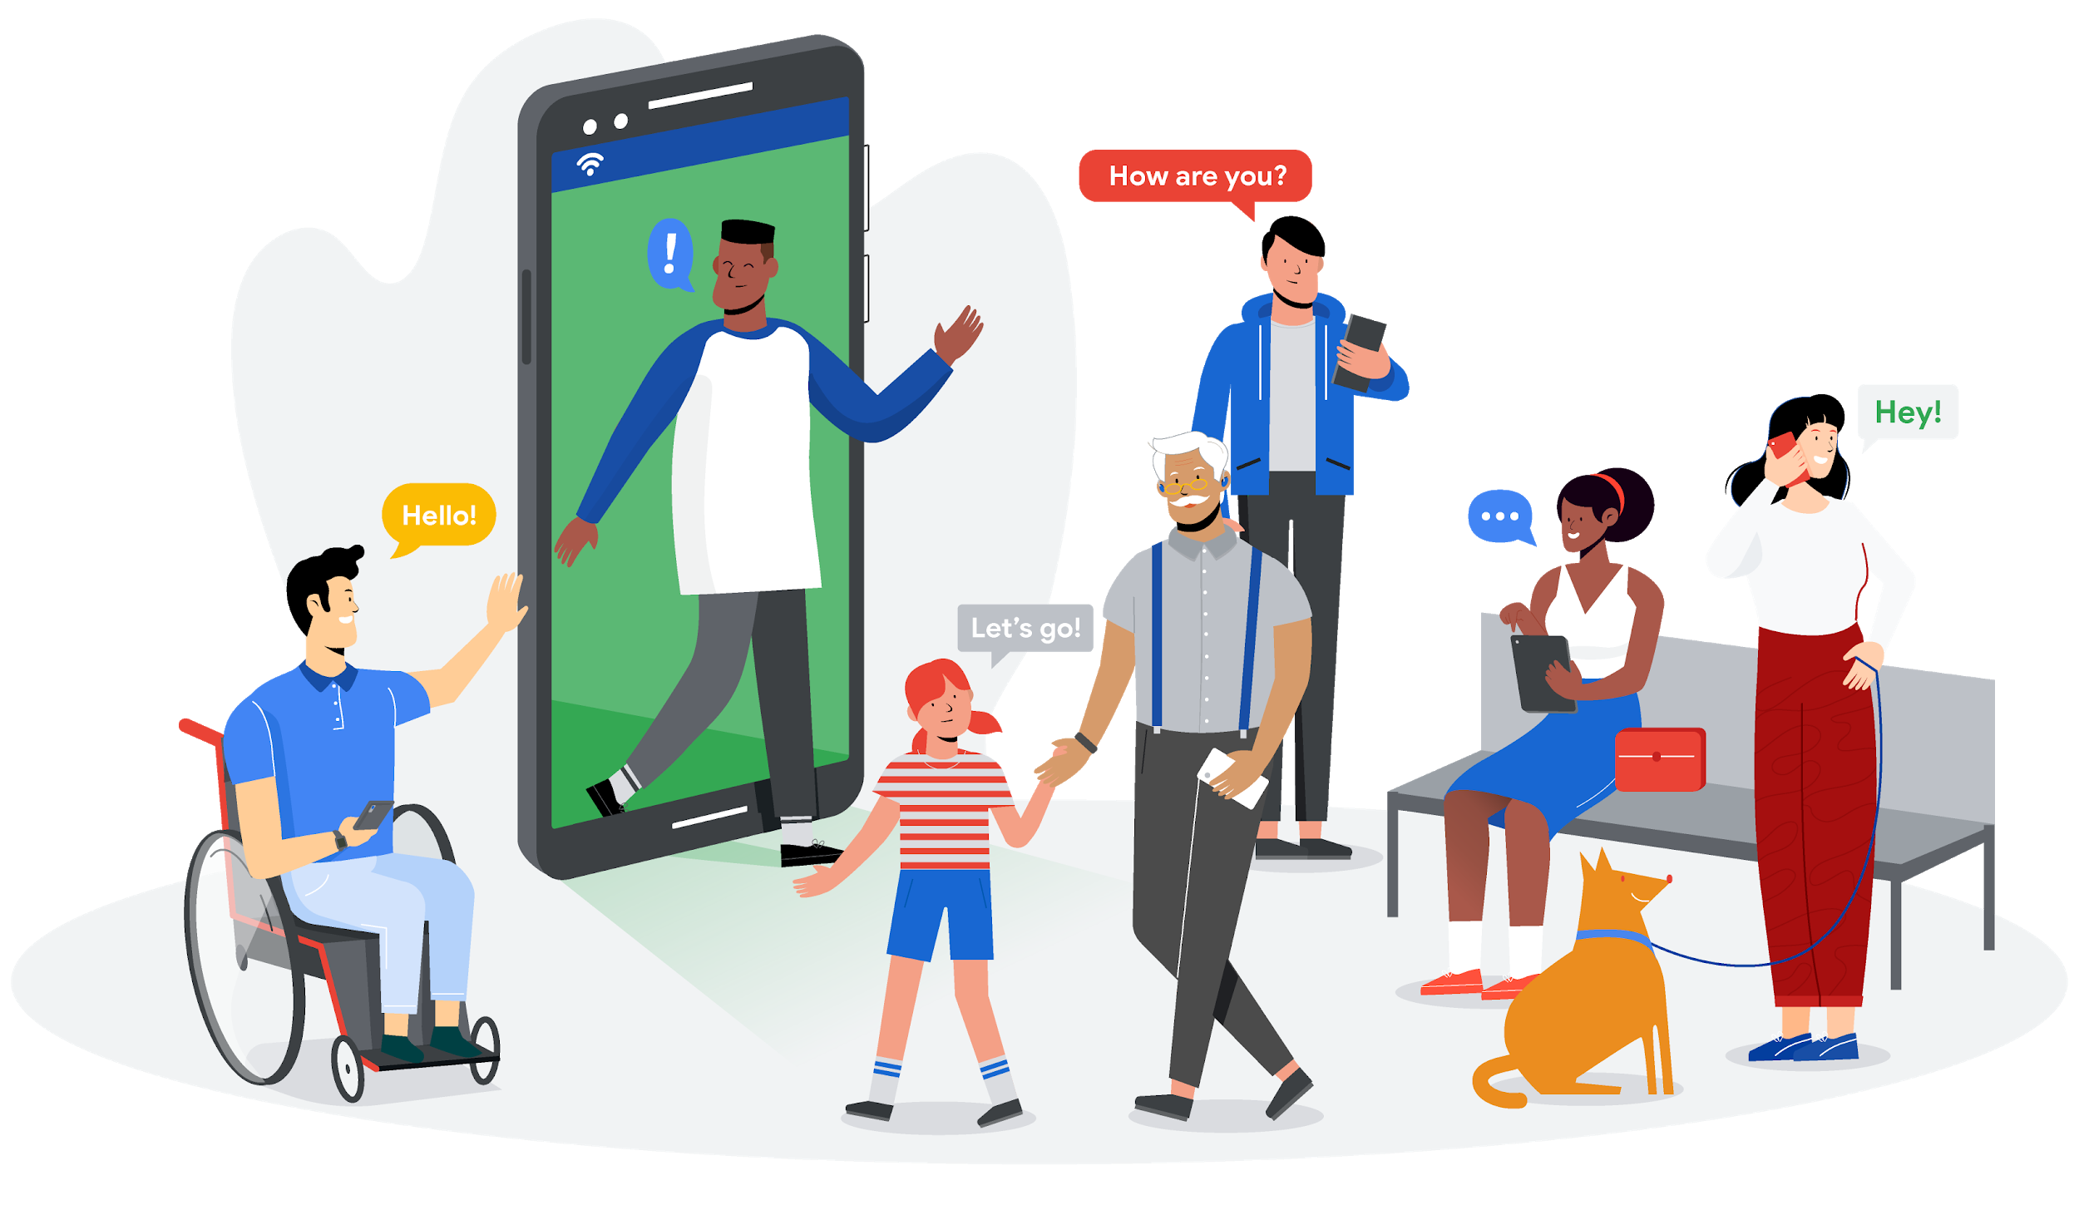
Intro | Mission
Universally Accessible
Google's Accessibility mission is about making products and the real world more accessible
Notes:
“Universally accessible” means everyone can use our products. We don’t expect users to adapt to our products.
It is with this mantra that we design, build and apply our "Google magic" to make both our products and the world around us, more accessible and more useful, for more users, in more situations.

Slide 13
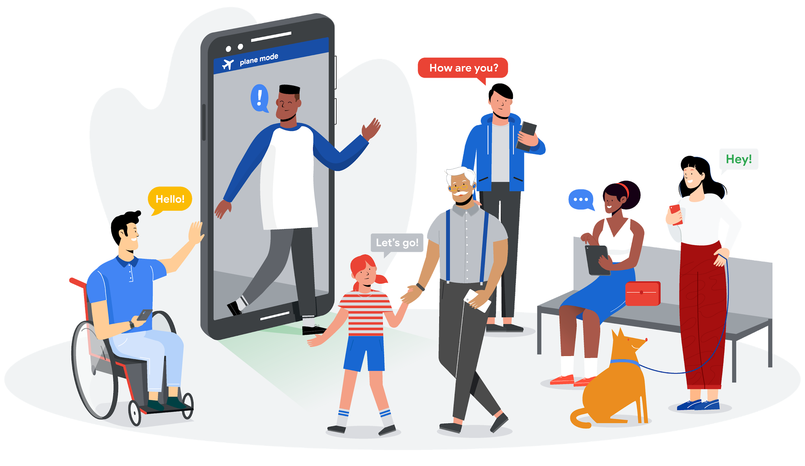
Intro | Mission
The World’s Information
Enriching experiences both on and off of the device
Notes:
The “world's information” means more than just making what’s already on the device accessible, but also designing experiences to make the real world more inclusive and participatory.
To do this, we apply advances in machine learning and artificial intelligence -- what I call the “Google magic” to meet the needs of underserved communities.

Slide 14
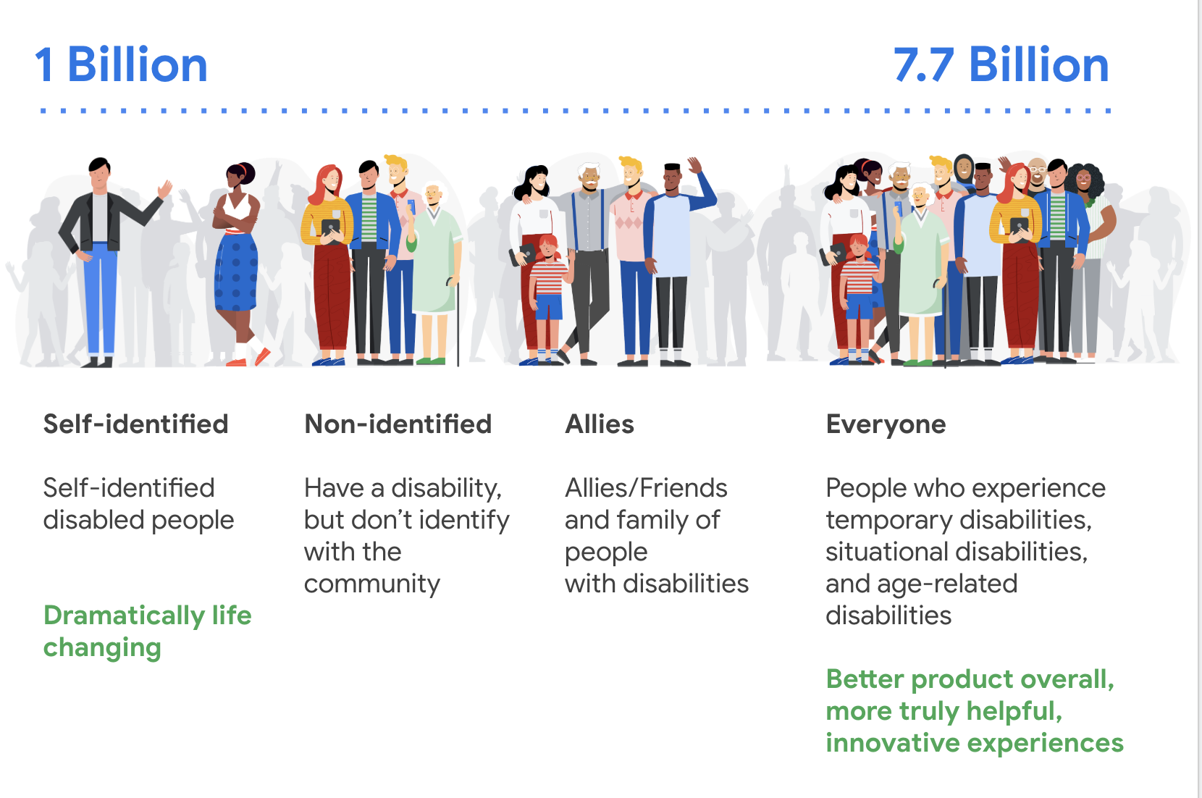
Disability affects Everyone

Slide 15
Building Inclusively

Slide 16
Dirty little secret
An important aspect of building any product is being intentional in exclusion.

Slide 17
Dirty little secret
An important aspect of building any product is being intentional in exclusion.
Why?

Slide 18
Dirty little secret
An important aspect of building any product is being intentional in exclusion.
Constraints of your project

Slide 19
Dirty little secret
An important aspect of building any product is being intentional in exclusion.
Constraints of your project
Ability to focus

Slide 20
Dirty little secret
An important aspect of building any product is being intentional in exclusion.
Constraints of your project
Ability to focus
… Accessibility is one of the constraints, our job is to keep it "above the line".

Slide 21
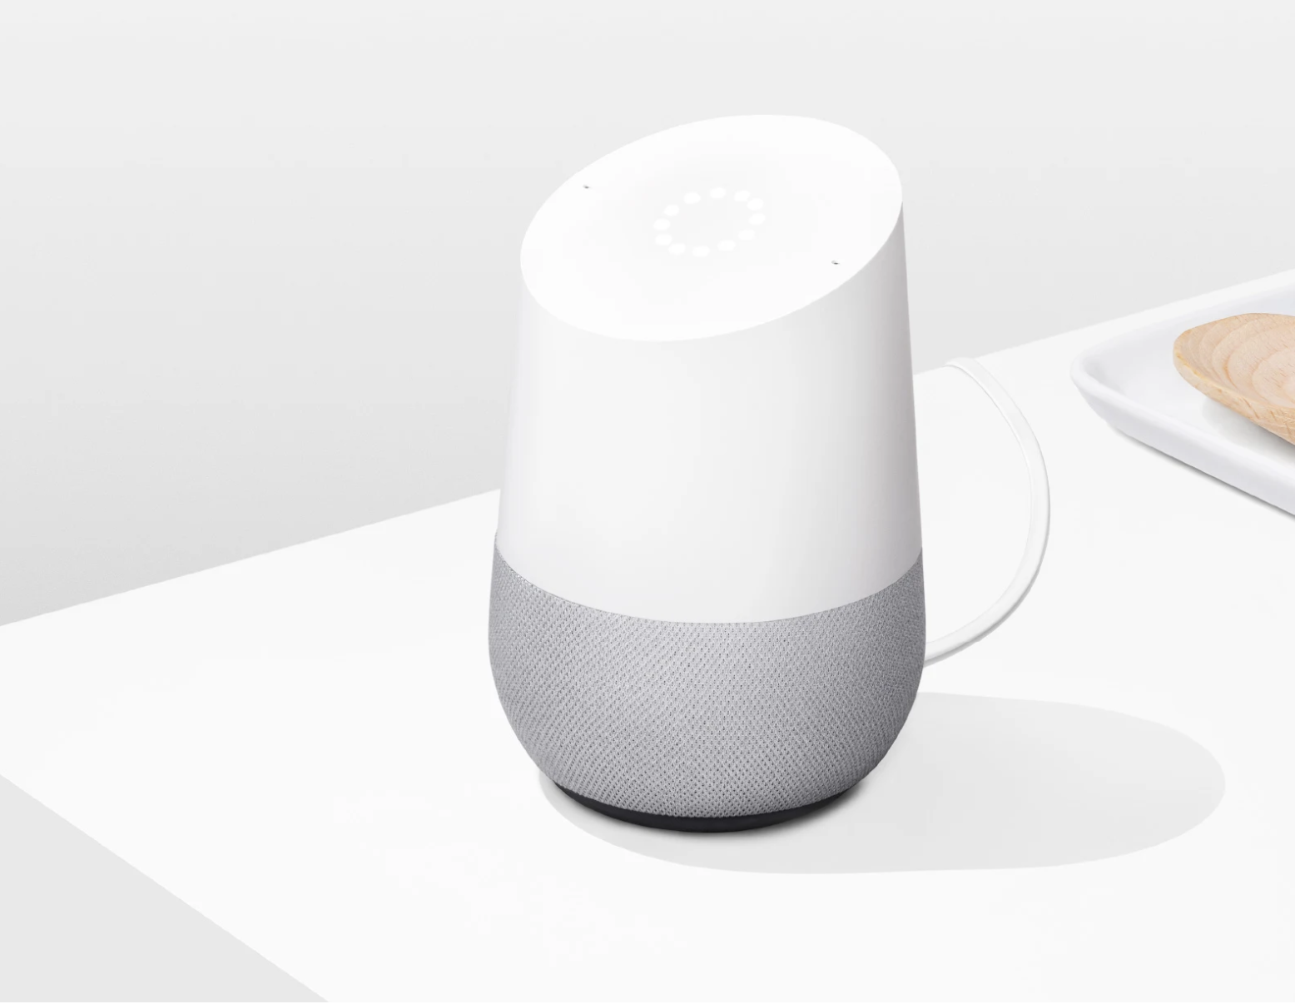
Google Home
Notes:
Google Home was created but it was never going to work for someone who is DHH. There was never a screen as part of the design, and that's okay. This is okay, eve with the FCC under their "readily achievable" guidance.

Slide 22
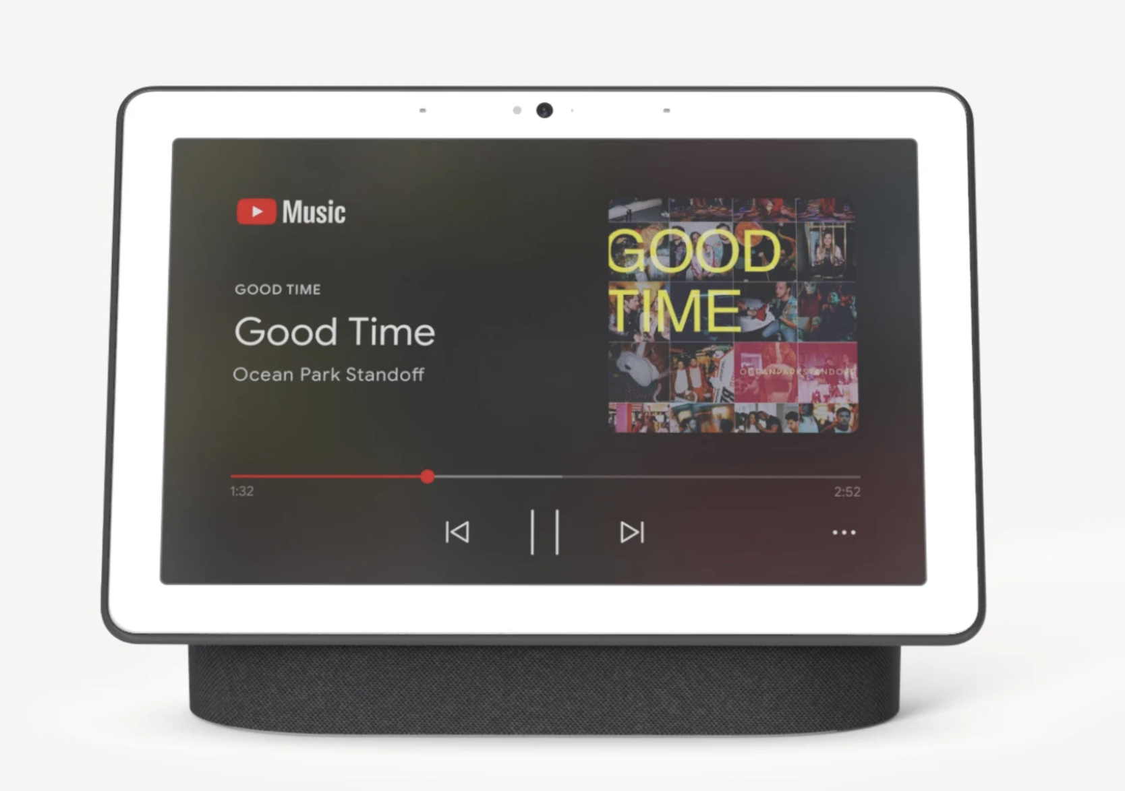
Nest Home Max
Notes:
...because later we created a product with a screen and a camera so it can be useful for more people. This has a screen present information and a camera, useful for video calls, which could be good for people using sign!

Slide 23
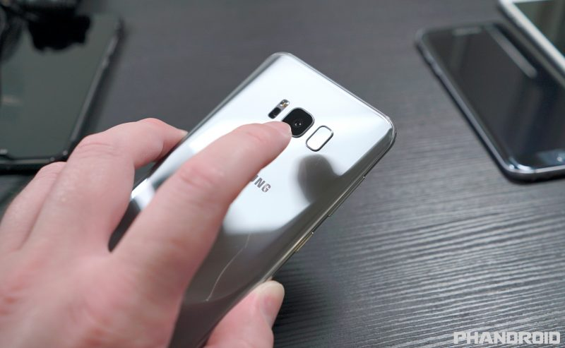
Planning. If you don't plan.
non symmetric sensor placement
inaccessible content
Bad for lefties, bad for photos
"button… button… button… image… button…"

Slide 24
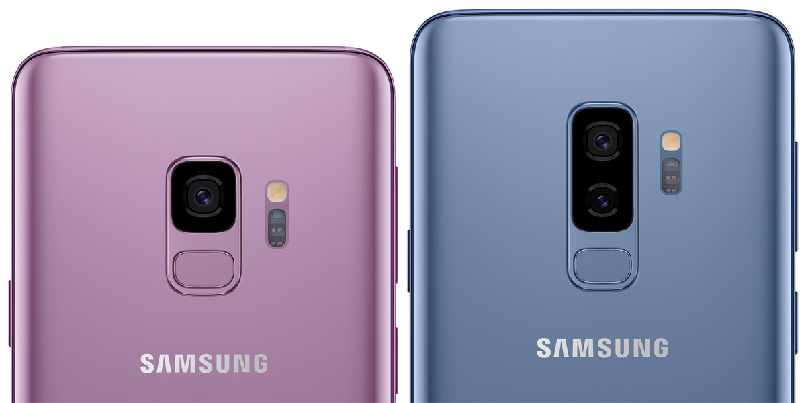
Planning. If you do.
central fingerprint placement
accessible content
good for everyone!
"Menu… Button…
Search… Button...
Homescreen one of two"

Slide 25
Building Inclusively: Key Methods

Slide 26
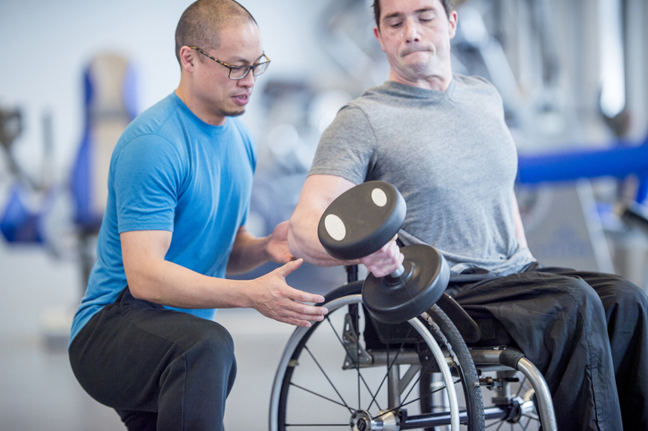
Leverage your strengths
Notes:
Do not try to tackle both something new for you and for an audience you do not deeply understand.
Google has a history of working with Artificial Intelligence and we try to use that to help us make our products more useful (Smart Compose) or to create new products (Lookout and Live Transcribe)

Slide 27
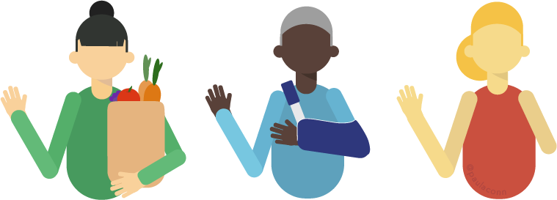
Never about us without us
Notes:
Do not fall into the trap creating a tool or product without close interaction with the people you're trying to support.
Think about all of the "ASL Gloves" that you've seen demonstrated. If they'd worked with people in the community, they would learn that it's not really solving the right problem. Besides, English <-> ASL translation (let alone interpretation) is really, really tough!

Slide 28
Start with one
Notes:
Start with a single person, build a solution that meets their need (with an eye to a broader solution) and then work with others to iterate on something that can be made more generic

Slide 29
Examples of Accessibility Innovation

Slide 30
Auditory: Captions

Slide 31
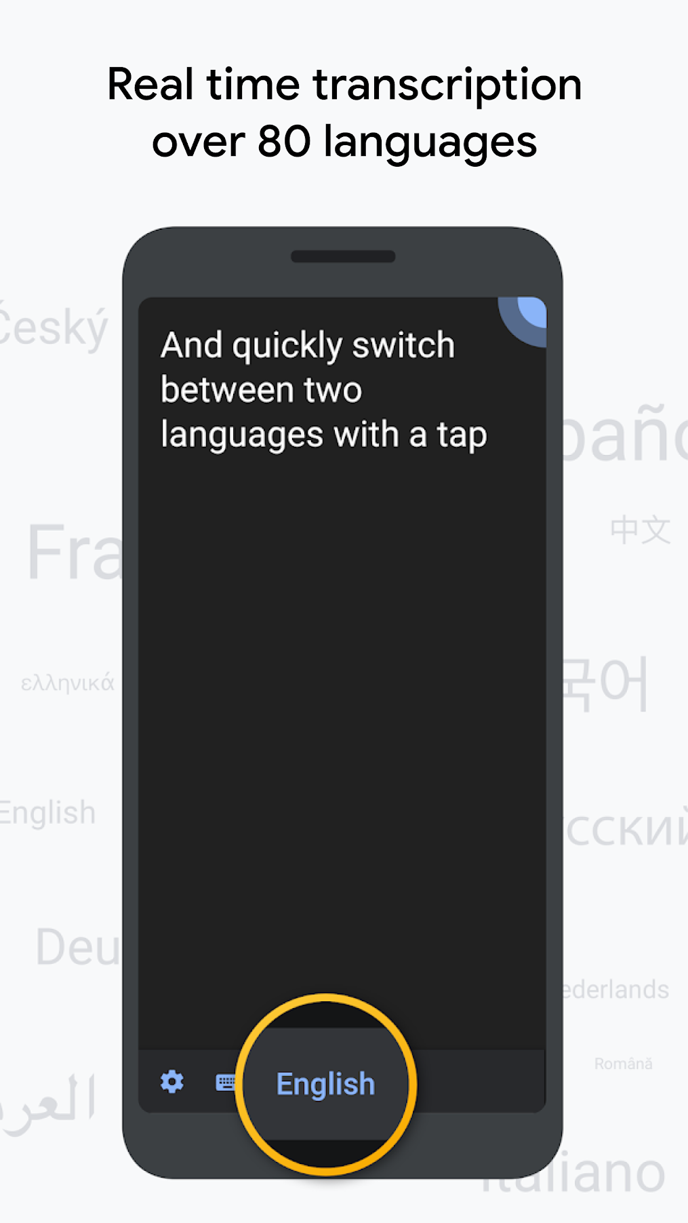
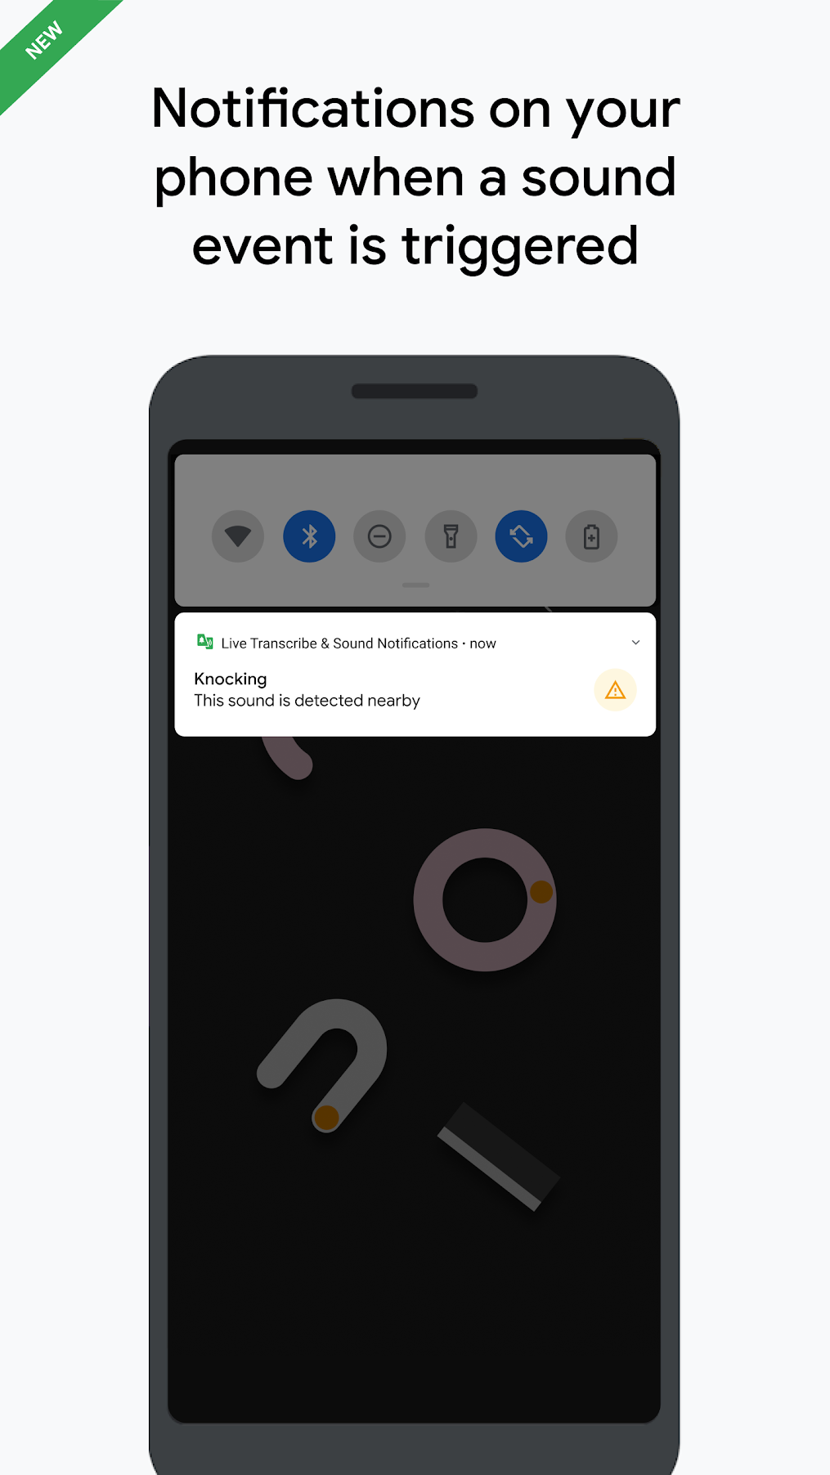
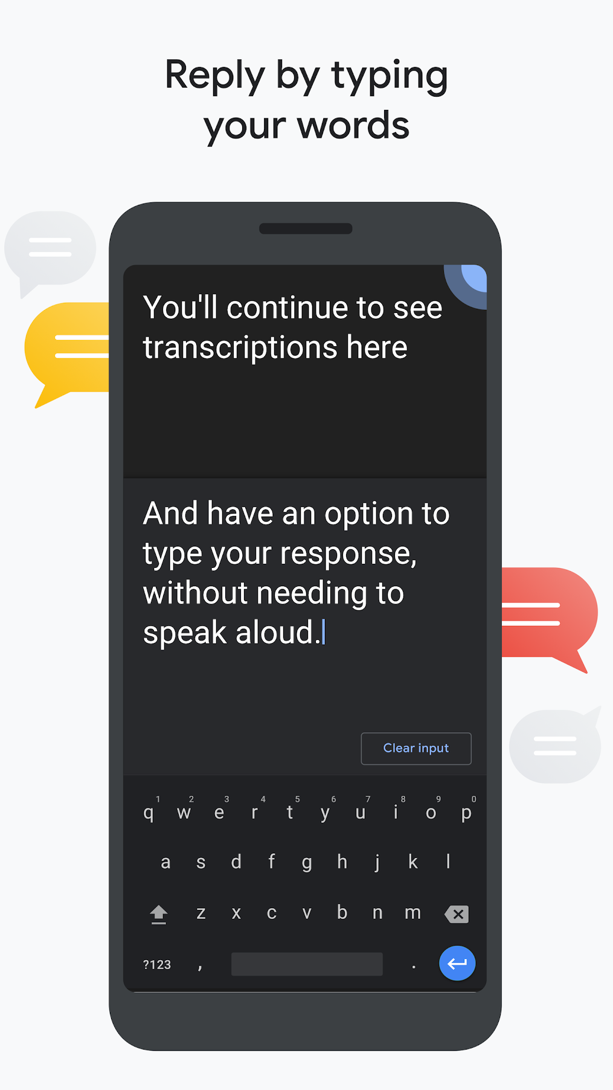
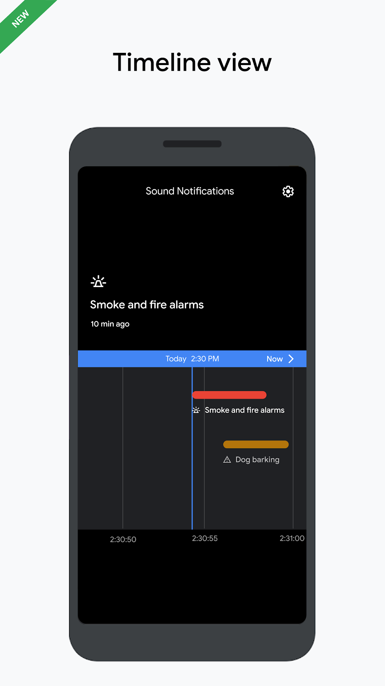
Live Transcribe & Sound Notifications
Notes:
Real-time transcription:
• Transcribes in real-time. Text appears on your phone as words are spoken.
• Accurately captures the nuances of how words are used in context.
• Choose from over 80 languages and dialects, and quickly switch between two languages.
• Add custom words that you use frequently, like names or household items.
• Set your phone to vibrate when someone says your name.
• Type responses in your conversation. Bring up your phone’s keyboard and type your words for a continuous dialogue. Transcriptions still appear while you type.
• Use external microphones found in wired headsets, Bluetooth headsets, and USB mics for better audio reception.
[New] Sound Notifications:
• Get notified of potential risky situations and personal situations based on sounds happening at home (for example, smoke alarm, siren, baby sounds).
• Get notifications with a flashing light or vibration to your mobile device or wearable.
• Timeline view lets you go back in history (currently limited to 12 hours) to see what was happening around you.
Referring back to transcription:
• Choose to save transcriptions for 3 days. Saved transcriptions will stay locally on your device for 3 days, so you can copy and paste them elsewhere. (By default, transcriptions are not saved.)

Slide 32
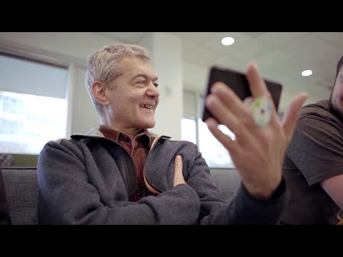
Live Transcribe & Sound Notifications
Notes:
Here's the story of LT

Slide 33
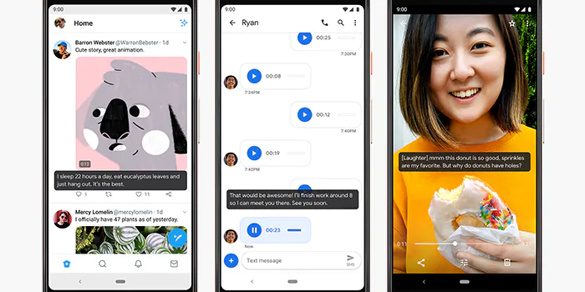
Live Caption: Android
Notes:
Works in all media on your device, including phone calls!

Slide 34
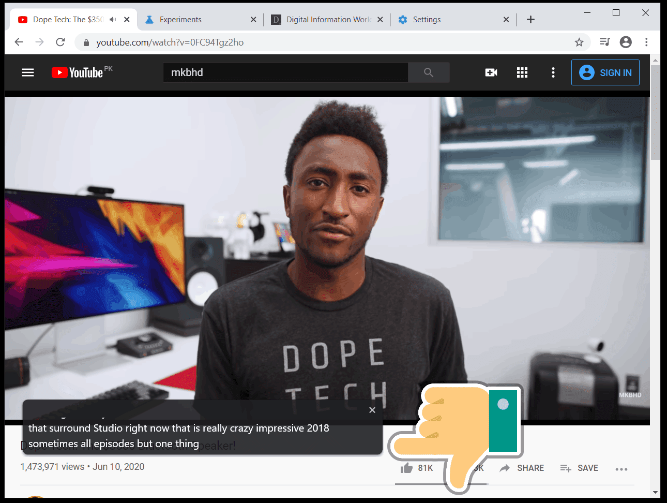
Live Caption: Chrome

Slide 35
Cognitive: Action Blocks

Slide 36
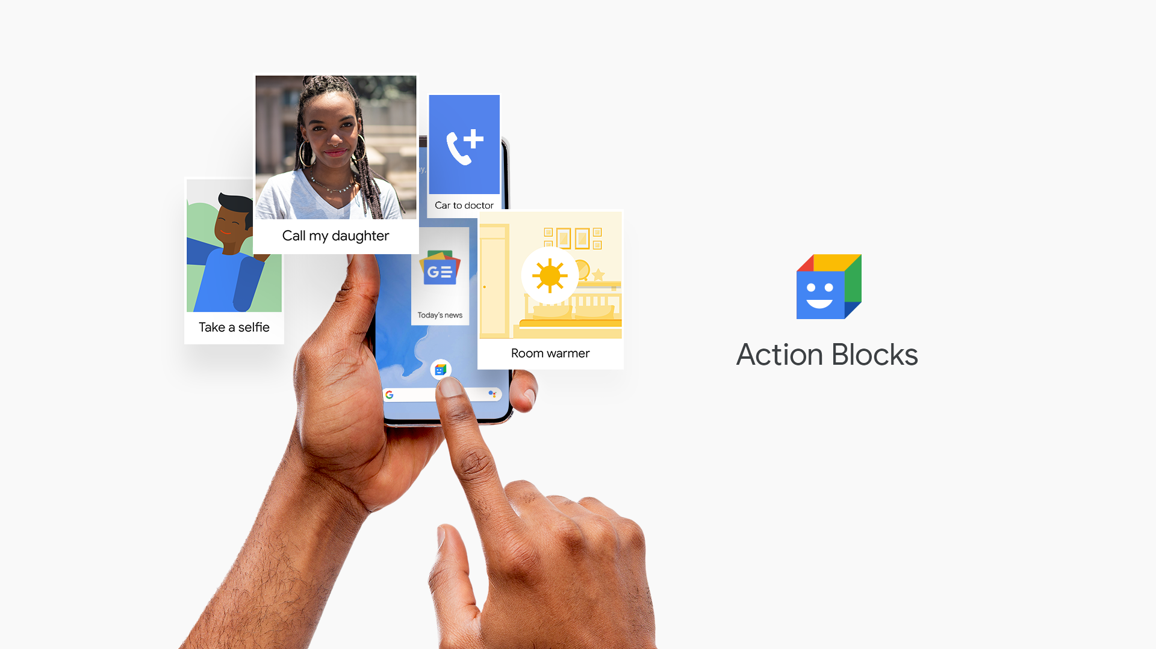
Action Blocks
Notes:
Action Blocks makes routine actions easier with customizable buttons on your Android home screen.
Powered by the Google Assistant, you can easily set up Action Blocks for a loved one. Action Blocks can be configured to do anything the Assistant can do, in just one tap: call a friend, watch your favorite show, control the lights, and more.
Designed in conjunction with people who use AAC devices, and their care givers, this is not just an app that makes it easier to use the Assistant (but it can do that)

Slide 37
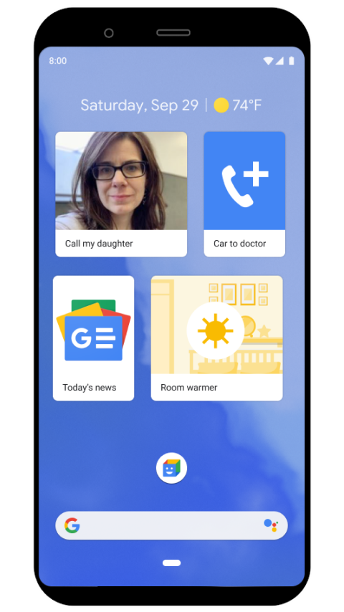
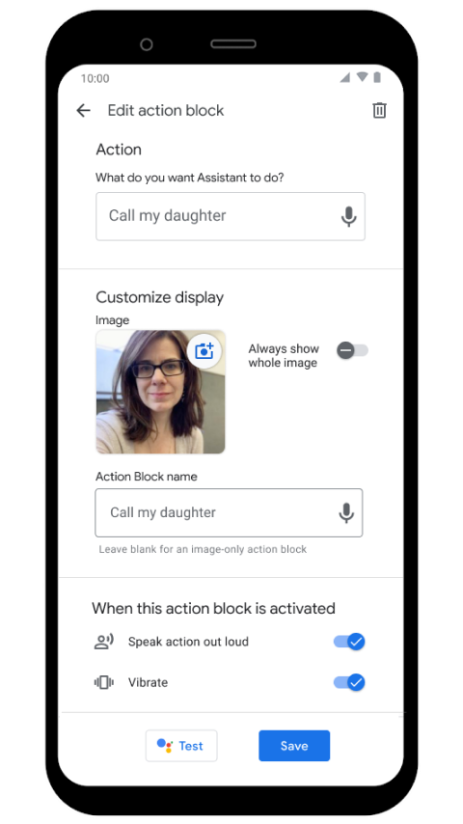
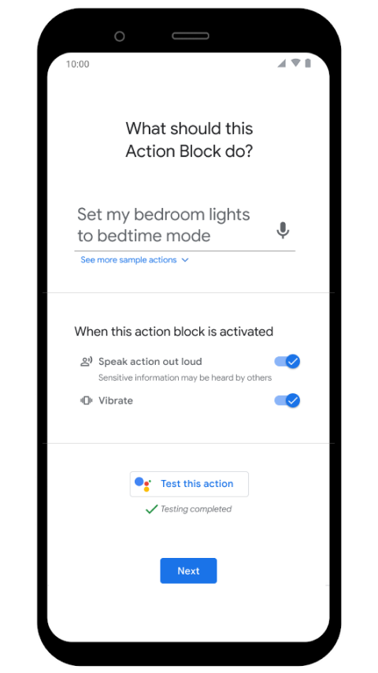
Action Blocks
Notes:
Built with the growing number of people with age-related conditions and cognitive differences in mind, Action Blocks can also be used for people with learning differences, or even for adults who want a very simple way to access routine actions on their phones. Set it up for your family, friends, or for yourself.
Action Blocks now features tens of thousands of picture communication symbols (PCS® by Tobii Dynavox), providing a seamless visual experience for users of augmentative and alternative communication (AAC) devices and special education software.
Action Blocks may also be useful for anyone who could benefit from an easier way to perform routine actions on their device, including individuals with dementia, aphasia, speech disorder, autism, spinal cord injury, traumatic brain injury, Down syndrome, Parkinson's disease, essential tremor, dexterity impairments, or other conditions. People who use adaptive switches, Switch Access, or Voice Access may also benefit.

Slide 38
Key Methods
Leverage your strengths

Slide 39
Key Methods
Leverage your strengths
Never about us without us

Slide 40
Key Methods
Leverage your strengths
Never about us without us
Start with one

Slide 41
Thank You!
Christopher Patnoe
patnoe@google.com
linkedin.com/in/patnoe

