Slide 1
CREATIVE INITIATIVE
How Designing for people with disabilities drives product innovation
HP Office of Aging & Accessibility: Sam Ogami and Jordan Ragan
May 2021

Slide 2
Agenda
Accessible print design process
Accessible print innovation
HP Hardware Accessibility Testing Guide
Outreach and product feedback

Slide 3
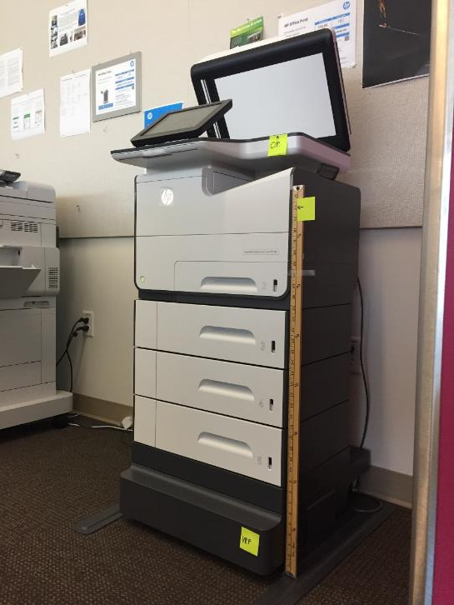
Hardware accessibility: Process
Start by listening
Include people with disabilities in research and evaluation
Contextual inquiries: observe user’s needs and behavior in their environment
Resonance test: interview questions and discussions based on observation and hypothesis
Concept validation
Usability and accessibility testing
Functional and technical requirements

Slide 4
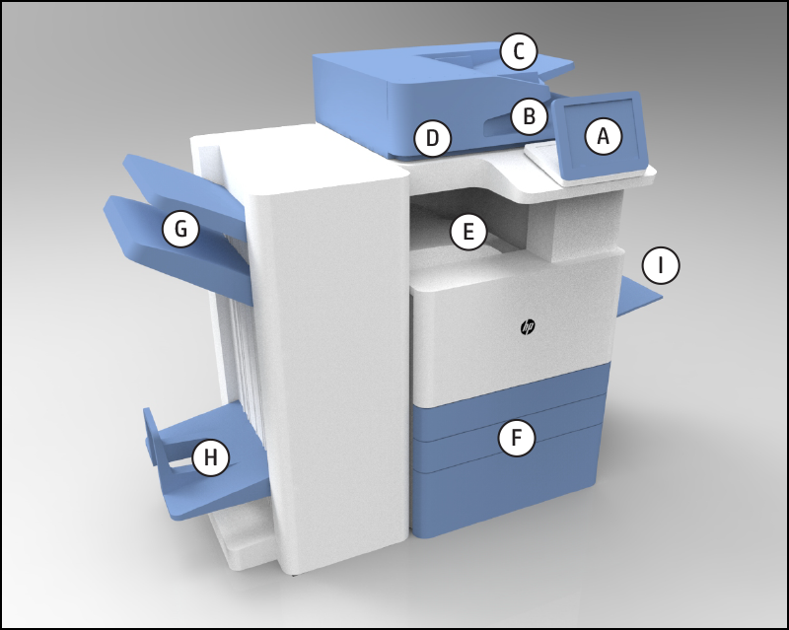
Accessibility with usability
Identify key features (e.g. print, copy, scan, fax)
Identify user touchpoints
Prioritize by usage (i.e. to daily, weekly, less-used), then installation and maintenance functions
Simulate “real life” tasks for better usability
Each task represents a use case in the workplace
Identify elements of what is being done in the task (e.g. buttons, doors, keyboard, latches, scan glass, screen, screen hinge)
It must be an end-to-end complete test

Slide 5
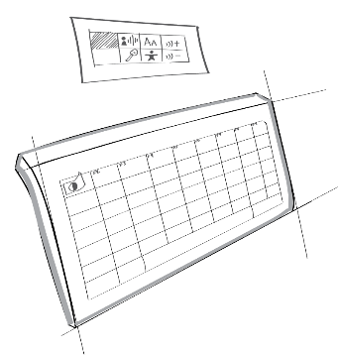
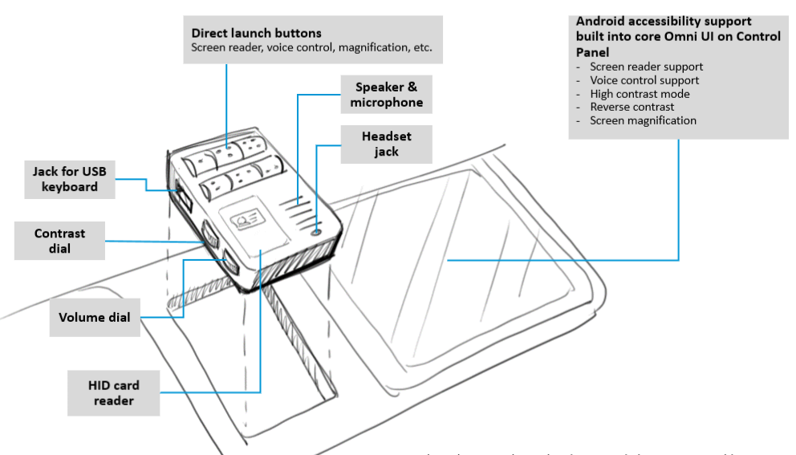
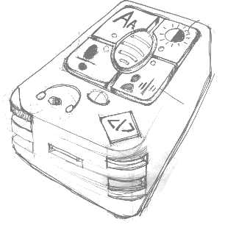
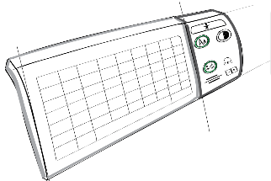
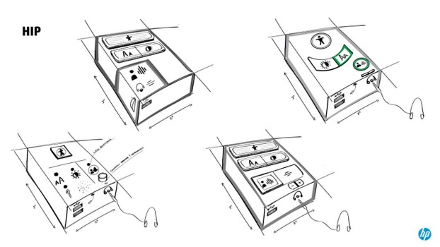
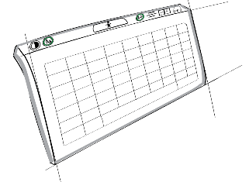
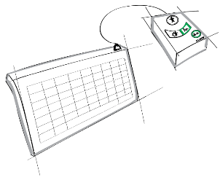
Concept testing: initial concept

Slide 6
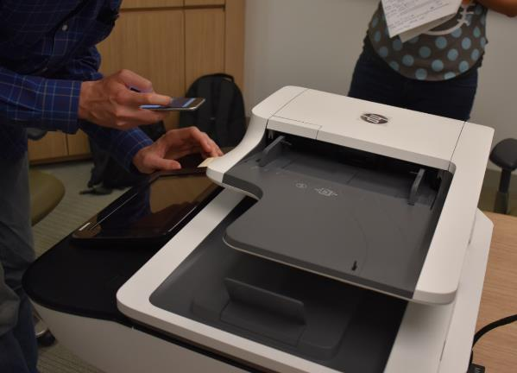
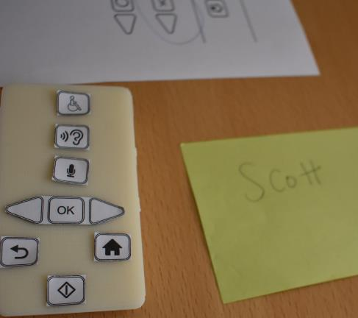
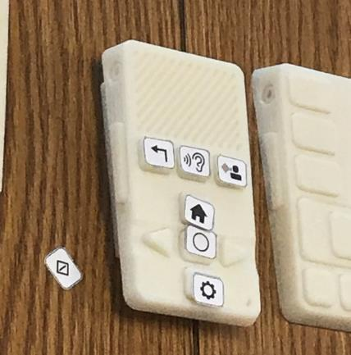
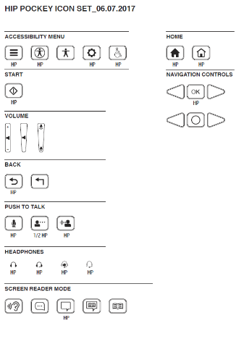
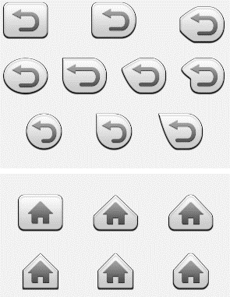
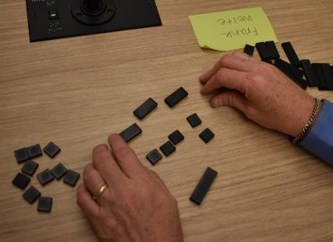
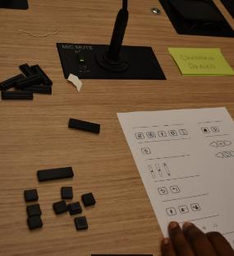
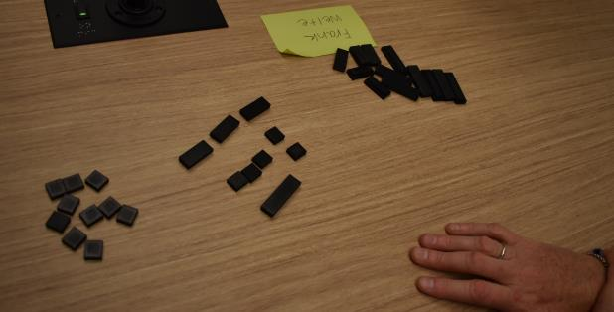
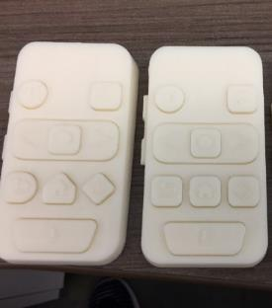
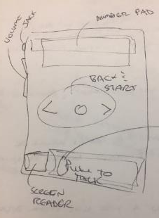
Participatory Design

Slide 7
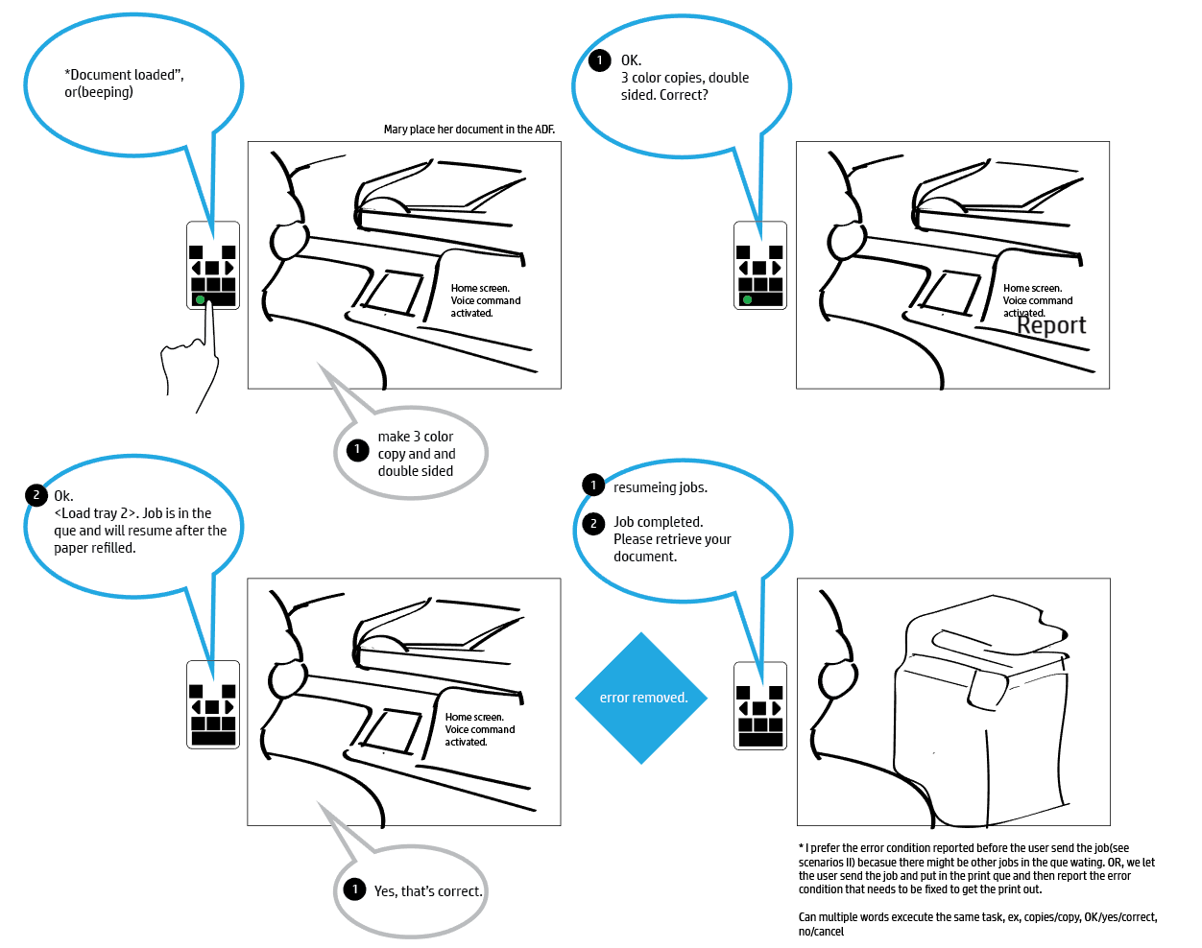
Voice command

Slide 8
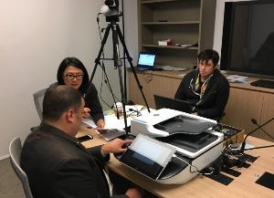
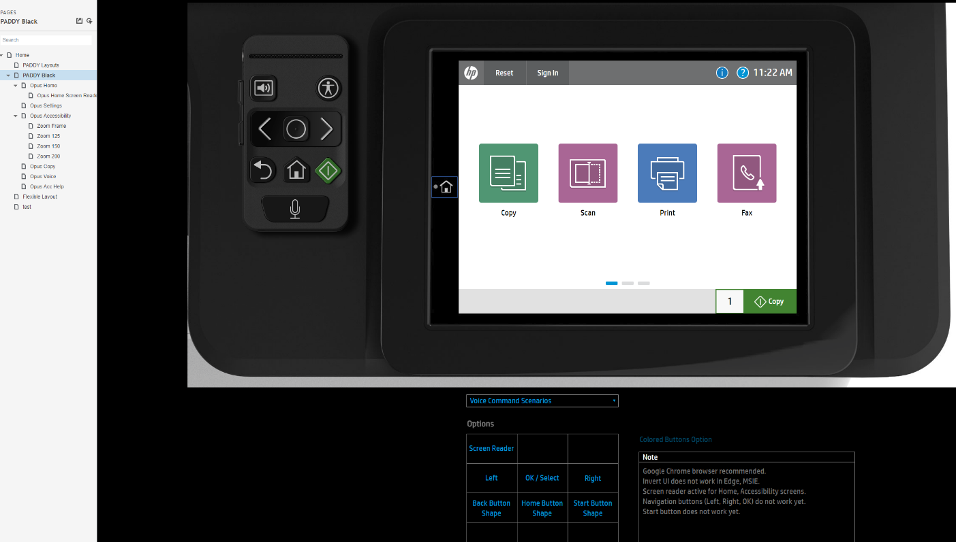
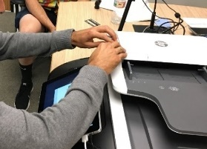
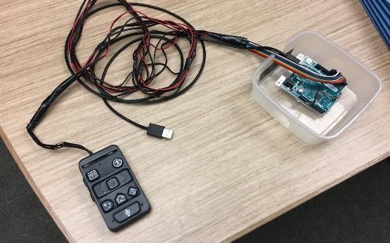
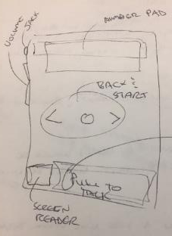
Working prototype

Slide 9
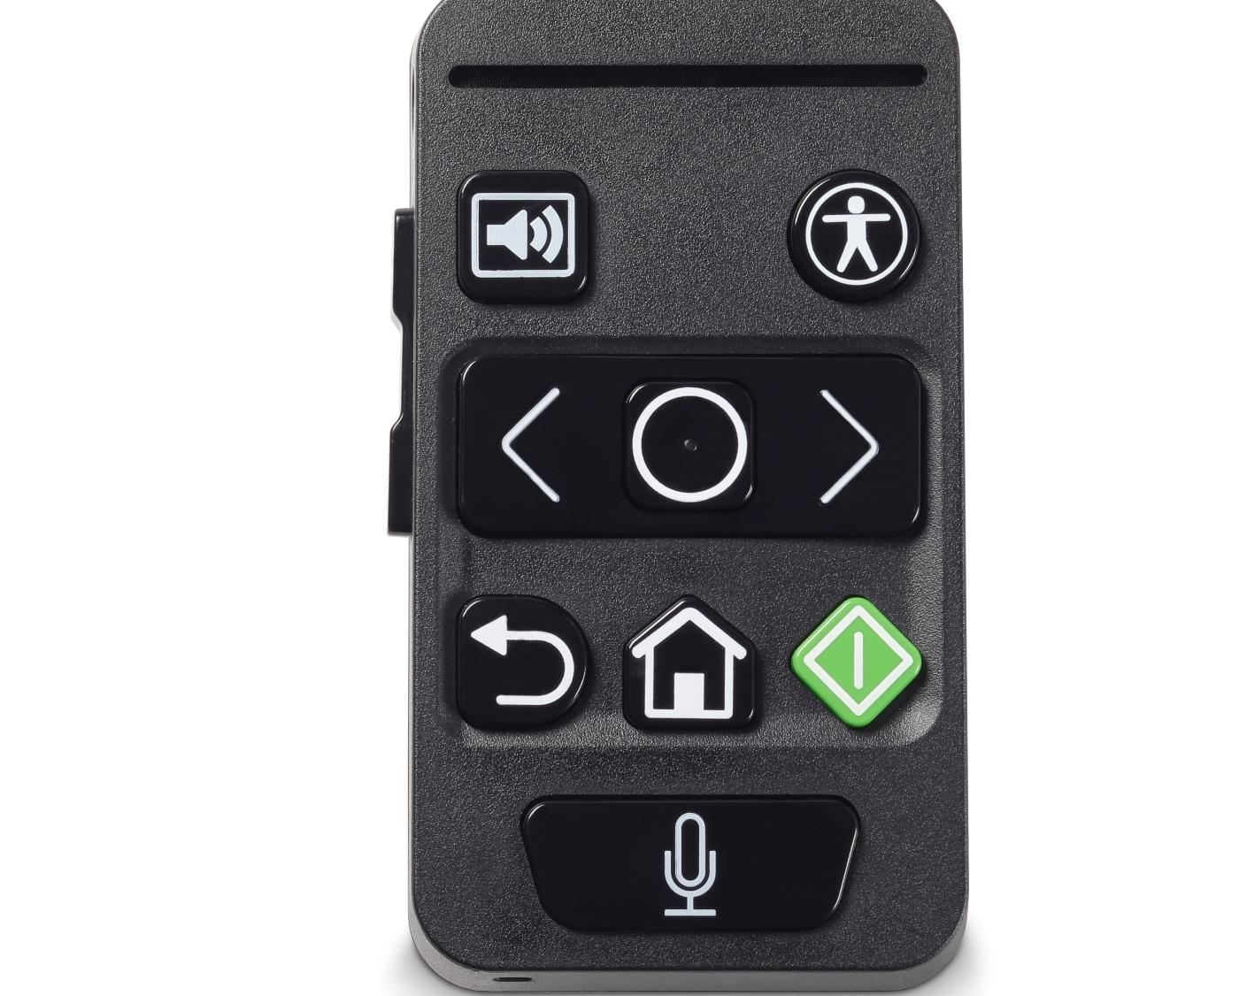
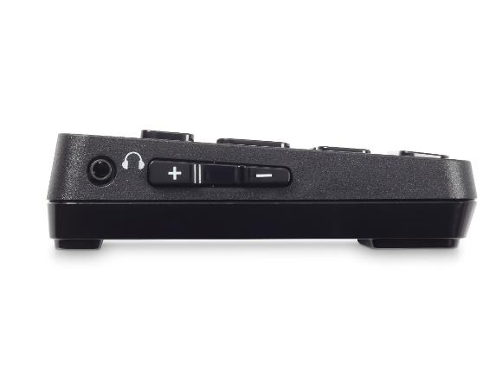
HP Accessibility Assistant
Headset Jack
Screen reader
HP Accessibility App
Volume up
Navigation group
Volume down
(left to right)
Back
Home
Start
Voice command

Slide 10
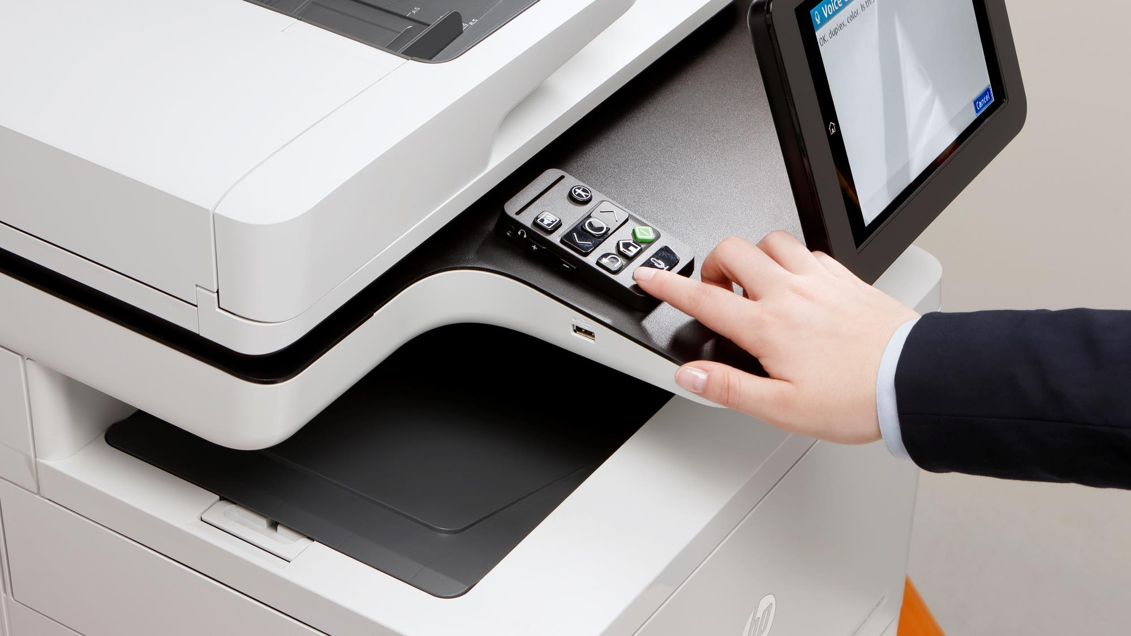
HP Accessibility Assistant in HIP

Slide 11
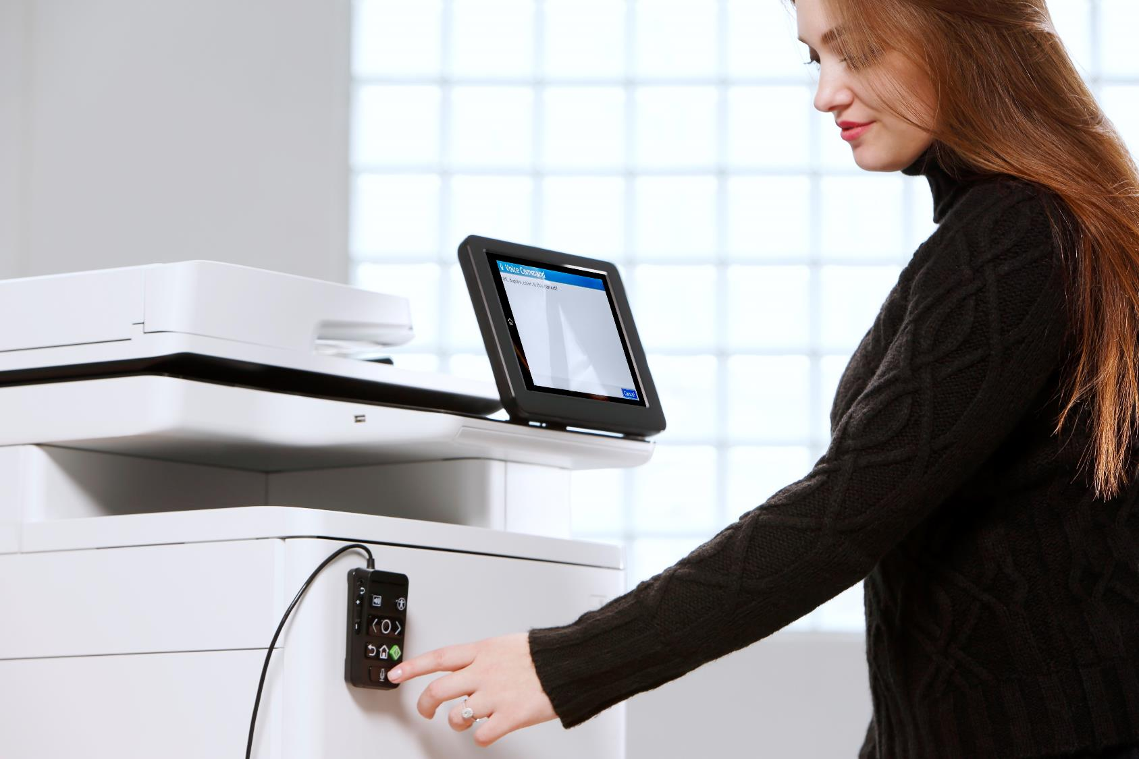
HP Accessibility Assistant on side of printer

Slide 12
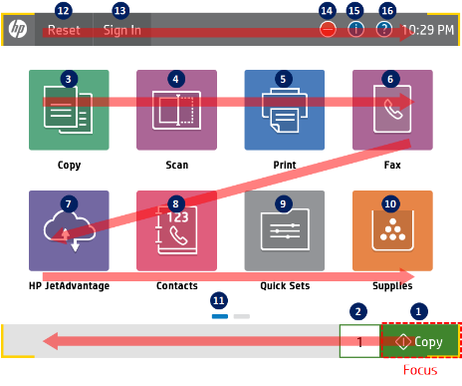
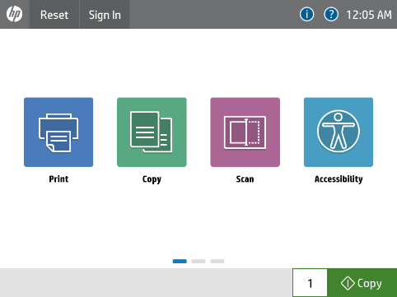
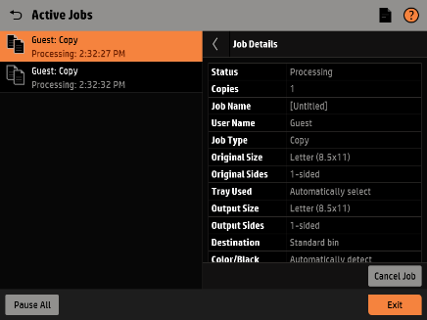
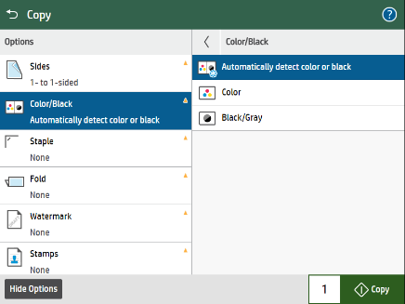
Out of the box Accessibility
Native Accessibility
Color contrast 4.5:1 ratio
No color only information
Support of third-party keyboards
Full keyboard access
Quickset keyboard shortcuts
HP Accessibility App
Built-in Assistive Technology
High contrast mode 7:1 ratio
Invert colors mode
Screen magnification

Slide 13
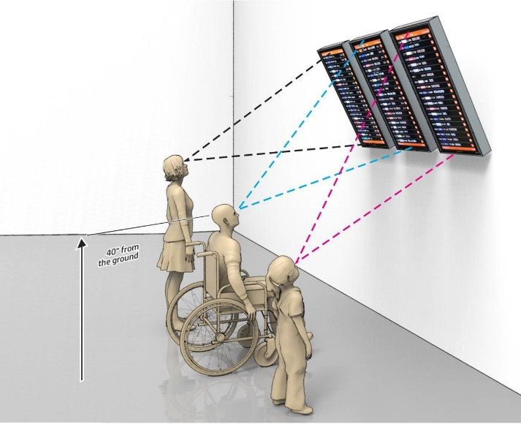
Hardware testing
Discover
Is this testing and reporting fact-based?
Is there information that a purchaser can use to see if they will have issues with it?
Does the testing seem reasonable?
Do workarounds exist?
If I test this hardware, will I get the same or a similar answer?
Are access needs or blocking issues present that would impede a user?

Slide 14
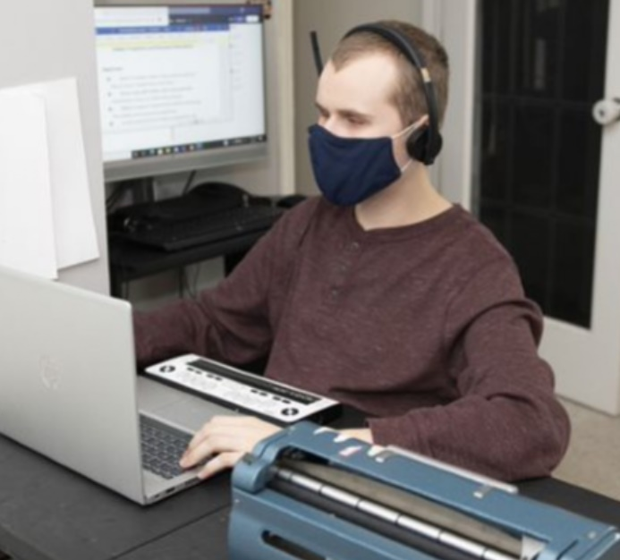
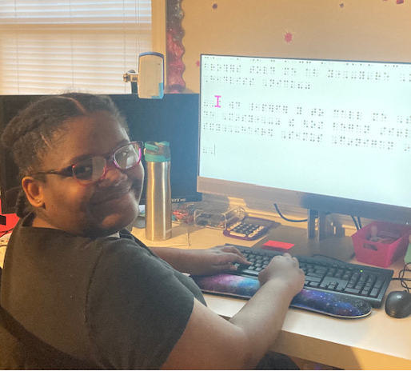
EMPOWERING STUDENTS
DYLAN
AMAYA
Notes:
Amaya uses the laptop, docking station, large screen monitor and external keyboard donated by HP to do a Braille lesson.
Dylan uses his donated HP laptop, external monitor, and headset to do his lessons from home. He also has a school-issued Braille display and Brailler to use.

Slide 15
MAKING IT HAPPEN
REMOTE
“Especially at this difficult time, when students can’t be physically in school, this technology has helped fill a big gap for us and helped students continue to learn remotely.”
LEARNING
CREATIVITY
CONNECTION
“The technology is really helpful for his band class because his teacher can see how he’s playing an instrument. If he’s making any mistakes, she can correct them immediately.”
“He’s able to talk to his peers more and all of his teachers can see him now. With everyone in one place online it makes it easier for him to communicate with everybody.”

Slide 16
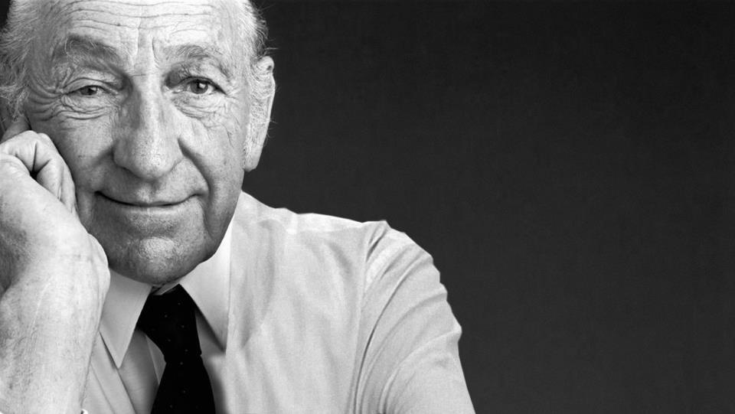
Dave Packard quote
“The betterment of our society is not a job to be left to a few. It is a responsibility to be shared by all.”
- Dave Packard, HP co-founder

